Slide 1
Nanotube Simulation Results
26/7/2020
Kate Trinkaus

Slide 2
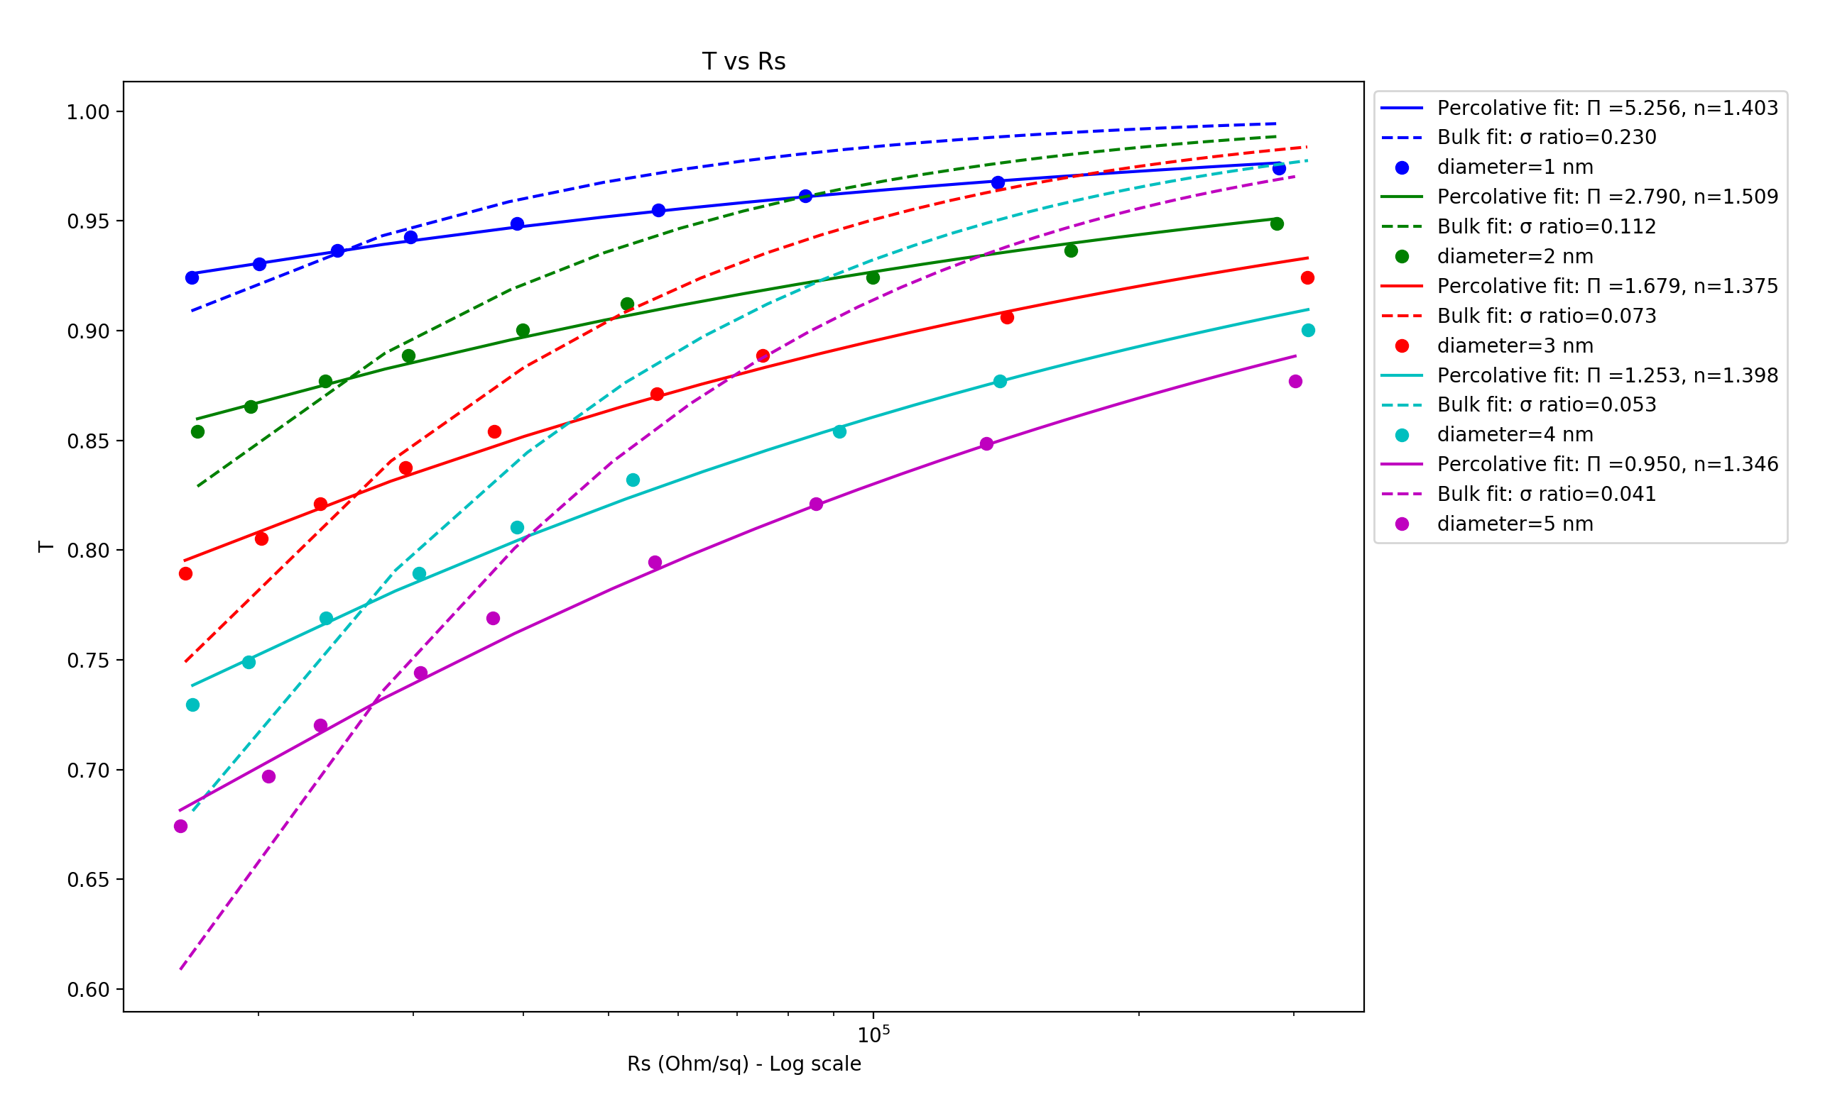
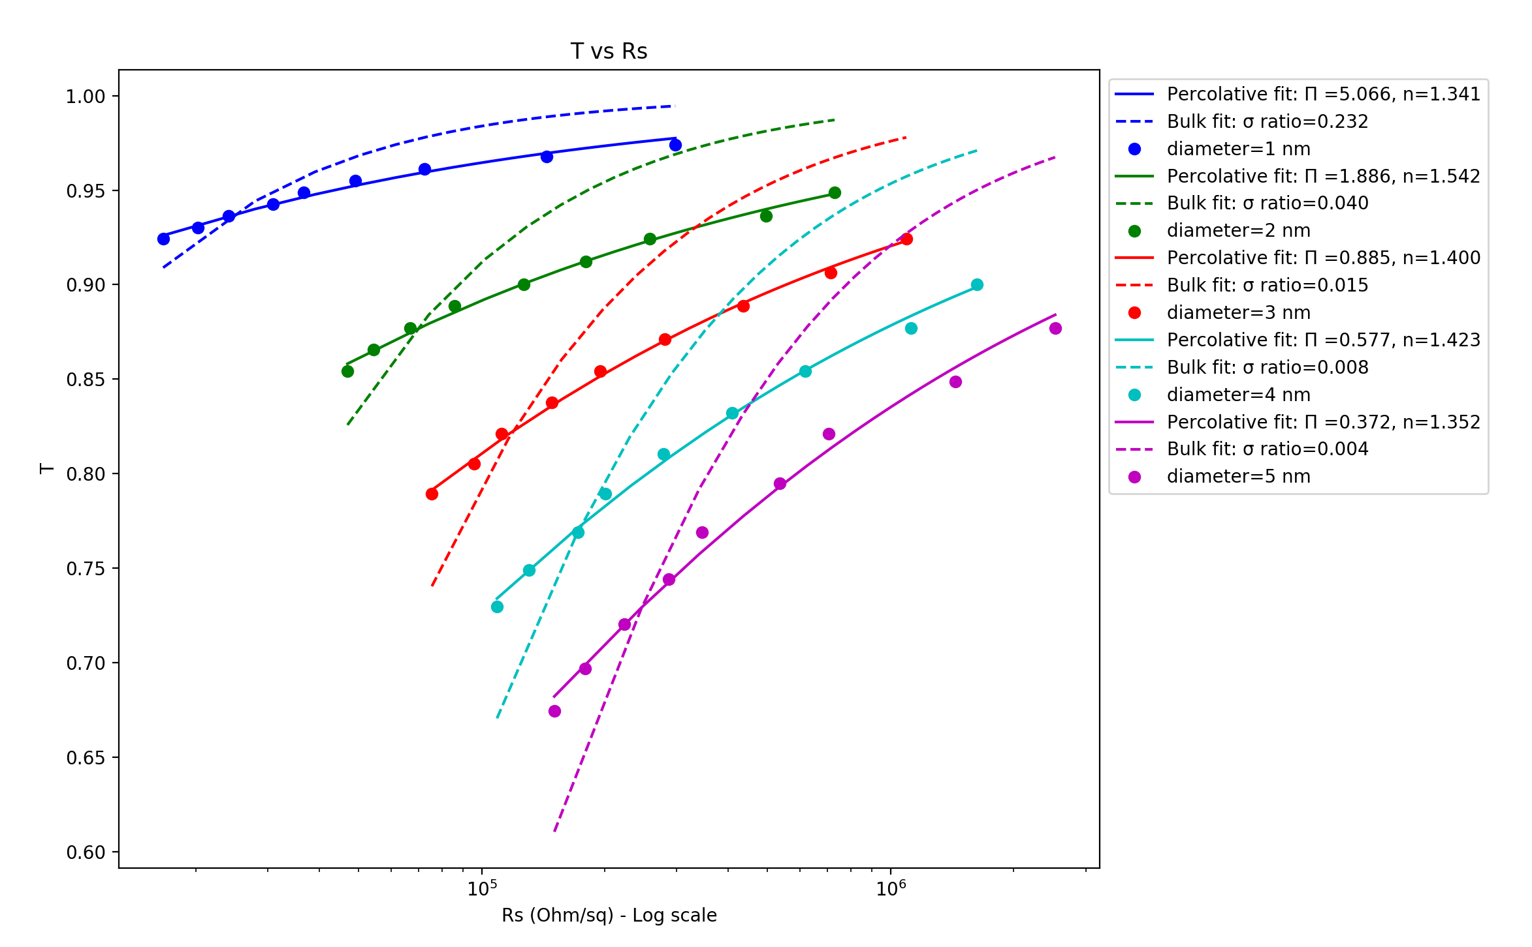
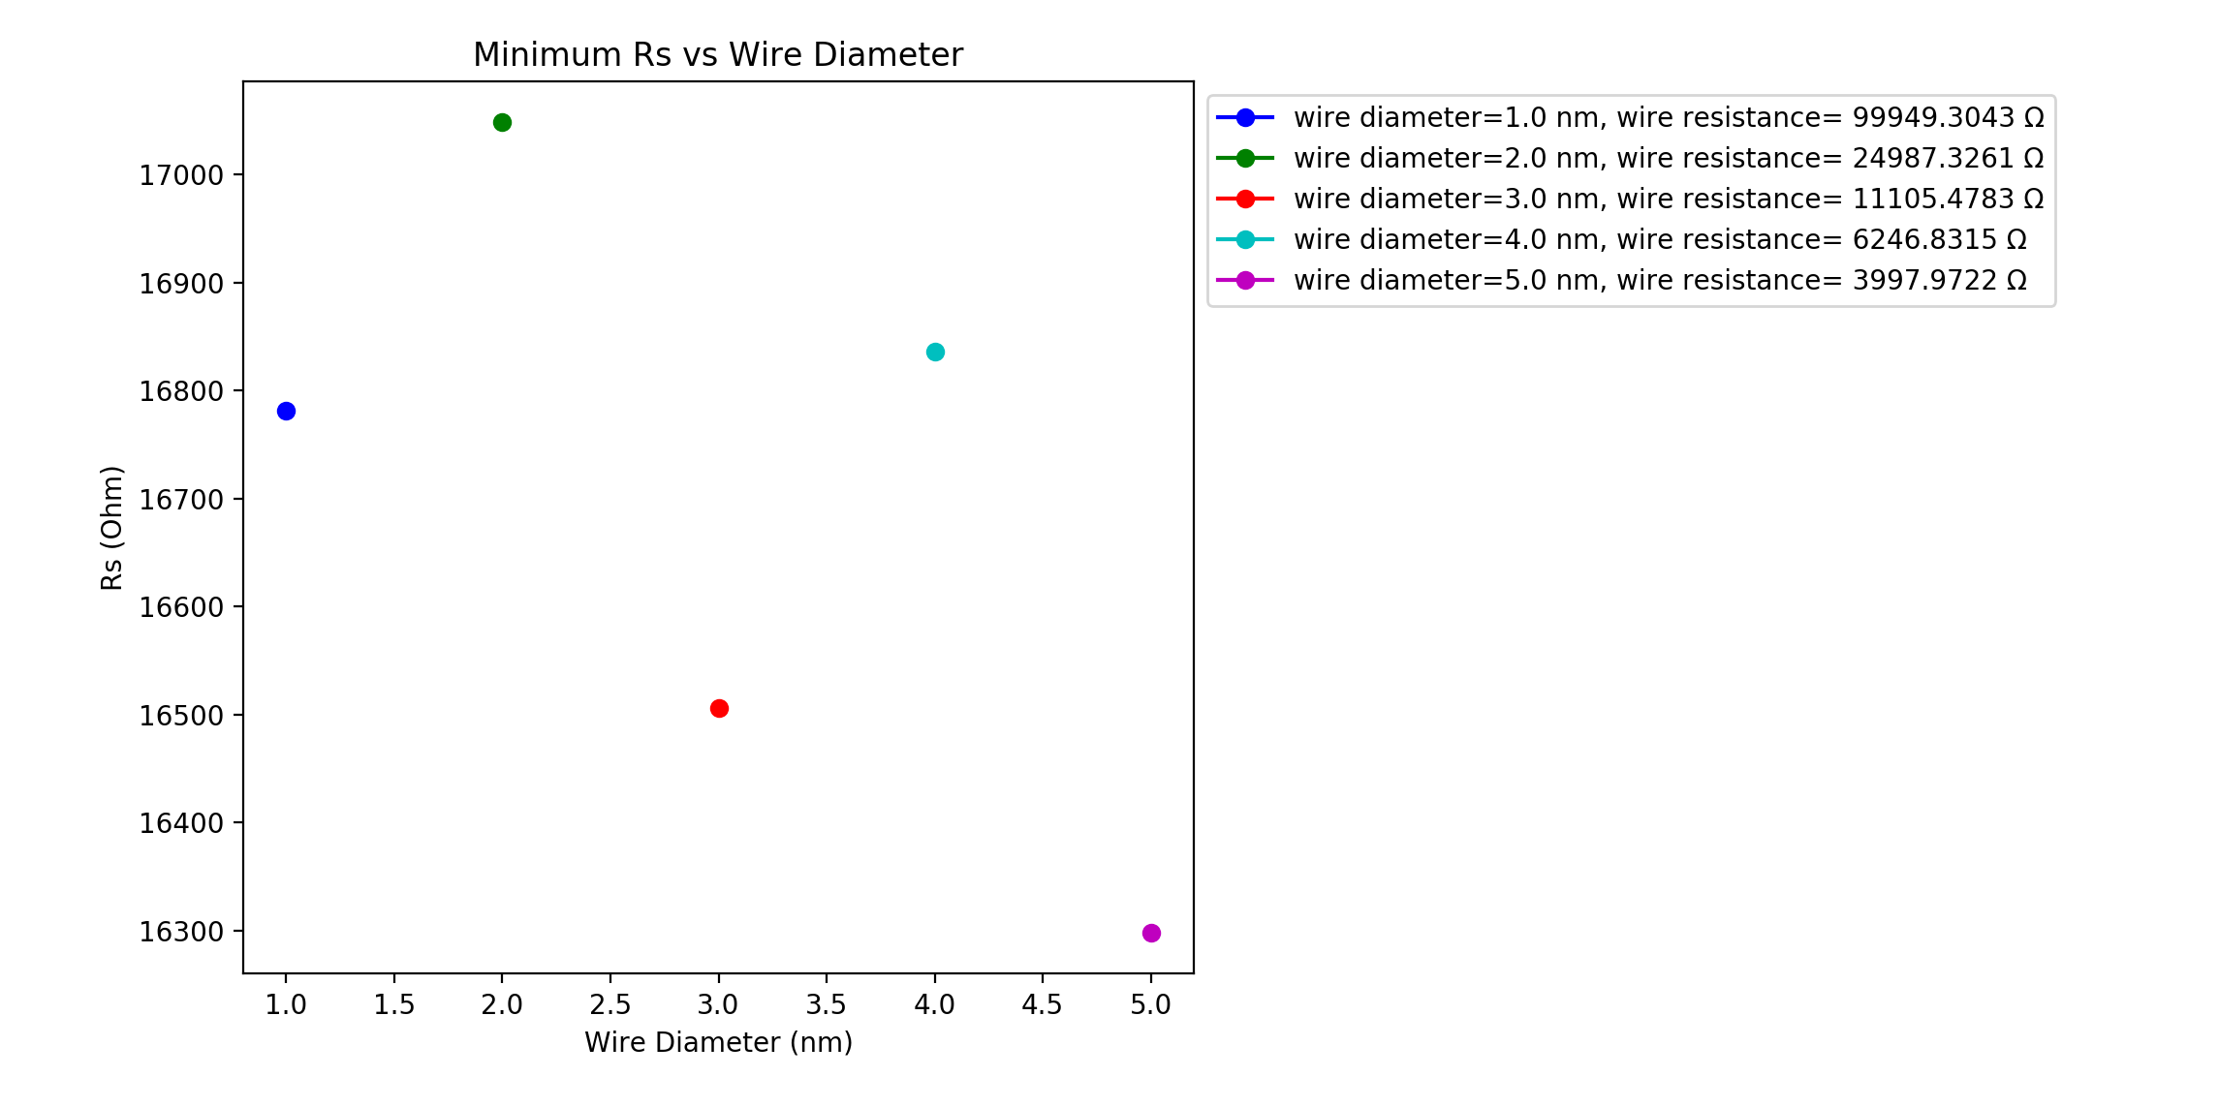
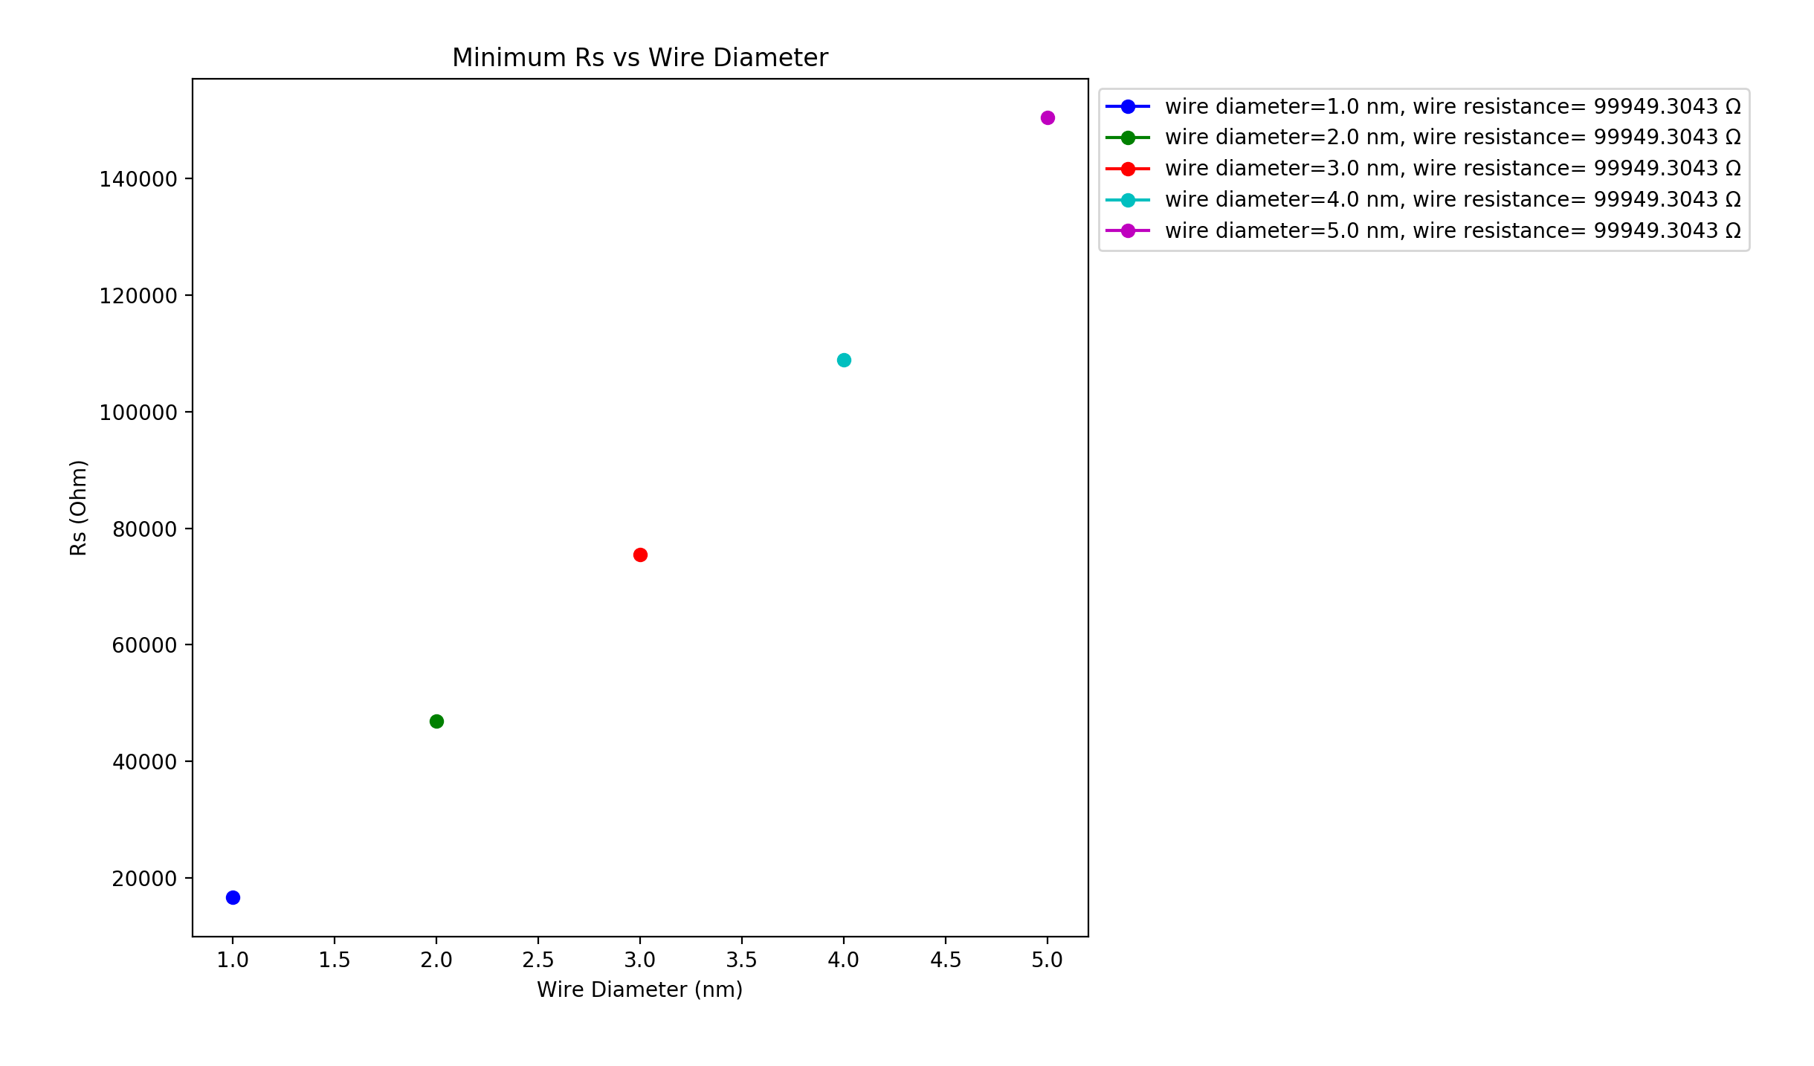
Vary Wire Diameter Constant 𝜌₀ (varying R_{wire} with diameter) Varying 𝜌₀ with diameter (constant R_{wire} ≃100kΩ)
Wire diameter: 1nm, Box length: 5um, Rjcn: 1Ω, Samples: 15, uniform wire length,
network density: 6.5644 to 19.6932 in 1.6411 wires/um² steps
Constant 𝜌₀ : 0.0785, Varying 𝜌₀ : 0.314 ·r²

Slide 3
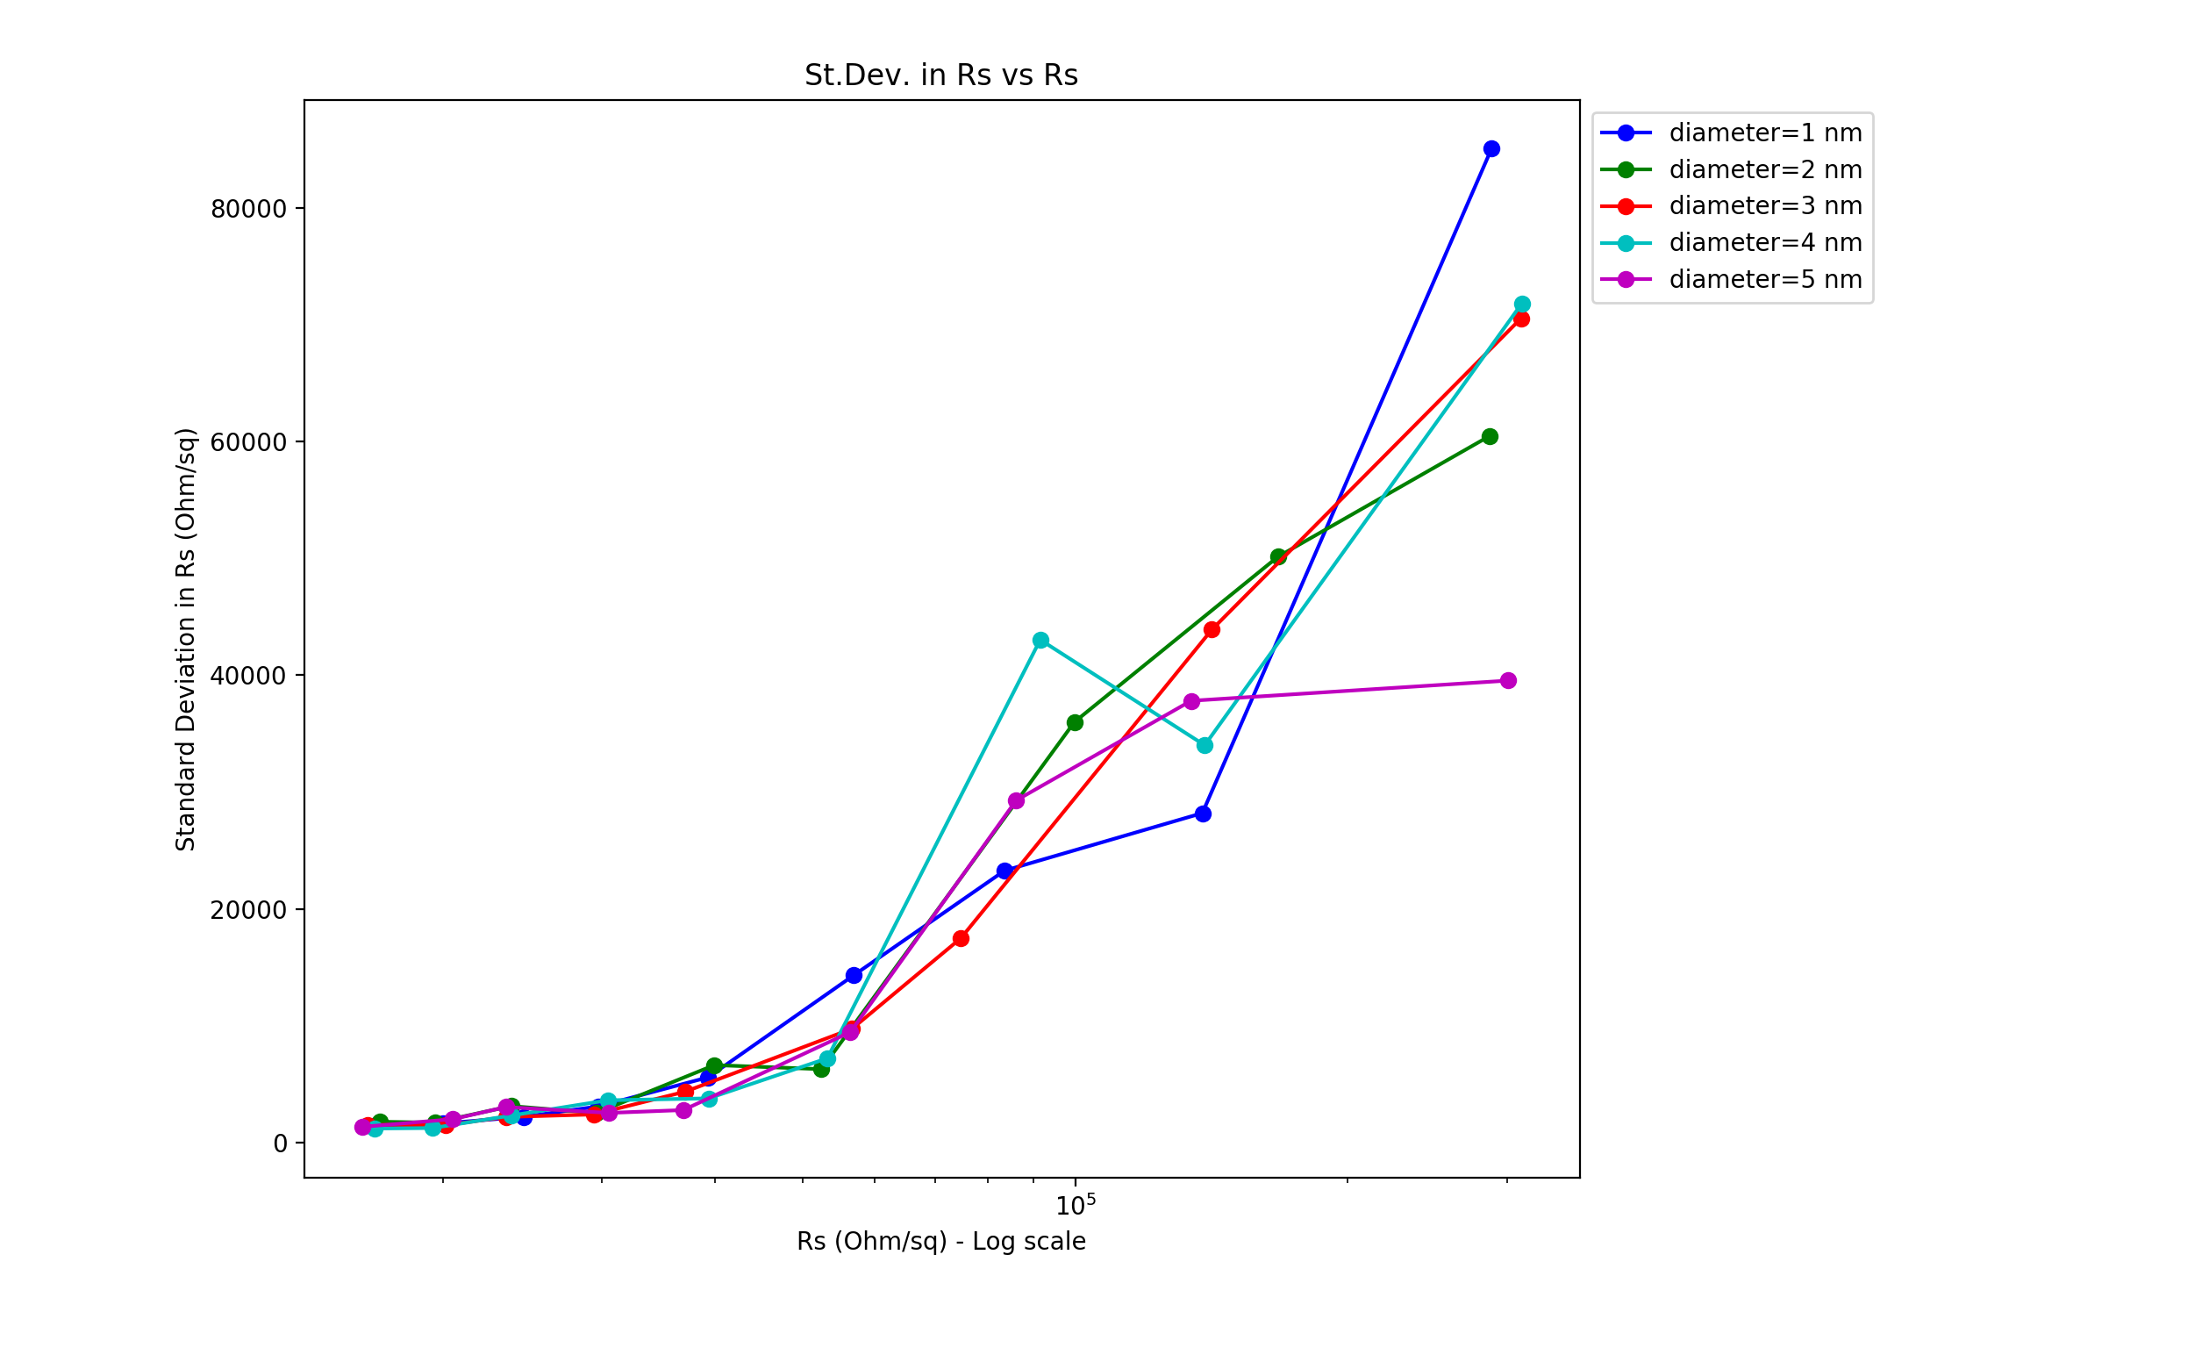
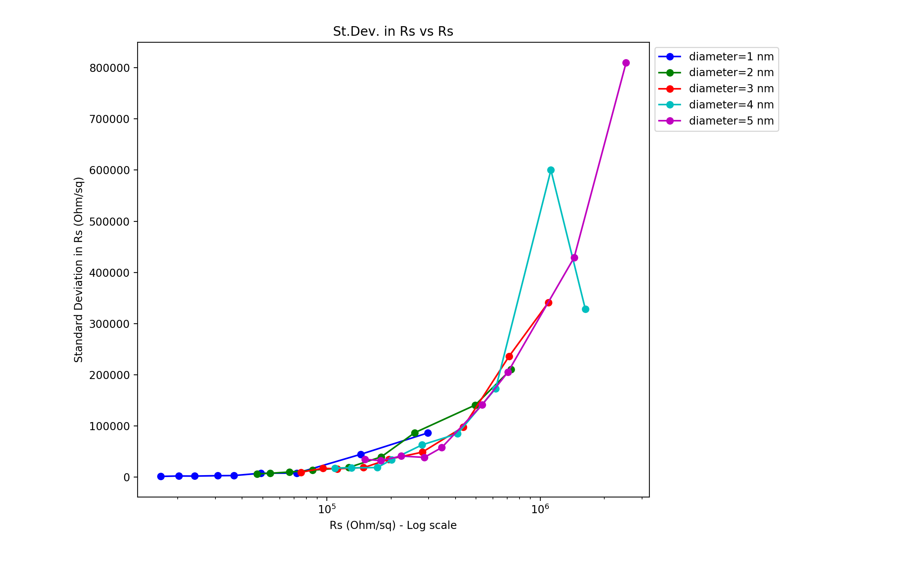
Vary Wire Diameter Constant 𝜌₀ (varying R_{wire} with diameter) Varying 𝜌₀ with diameter (constant R_{wire} ≃100kΩ)
Wire diameter: 1nm, Box length: 5um, Rjcn: 1Ω, Samples: 15, uniform wire length,
network density: 6.5644 to 19.6932 in 1.6411 wires/um² steps
Constant 𝜌₀ : 0.0785, Varying 𝜌₀ : 0.314 ·r²

Slide 4
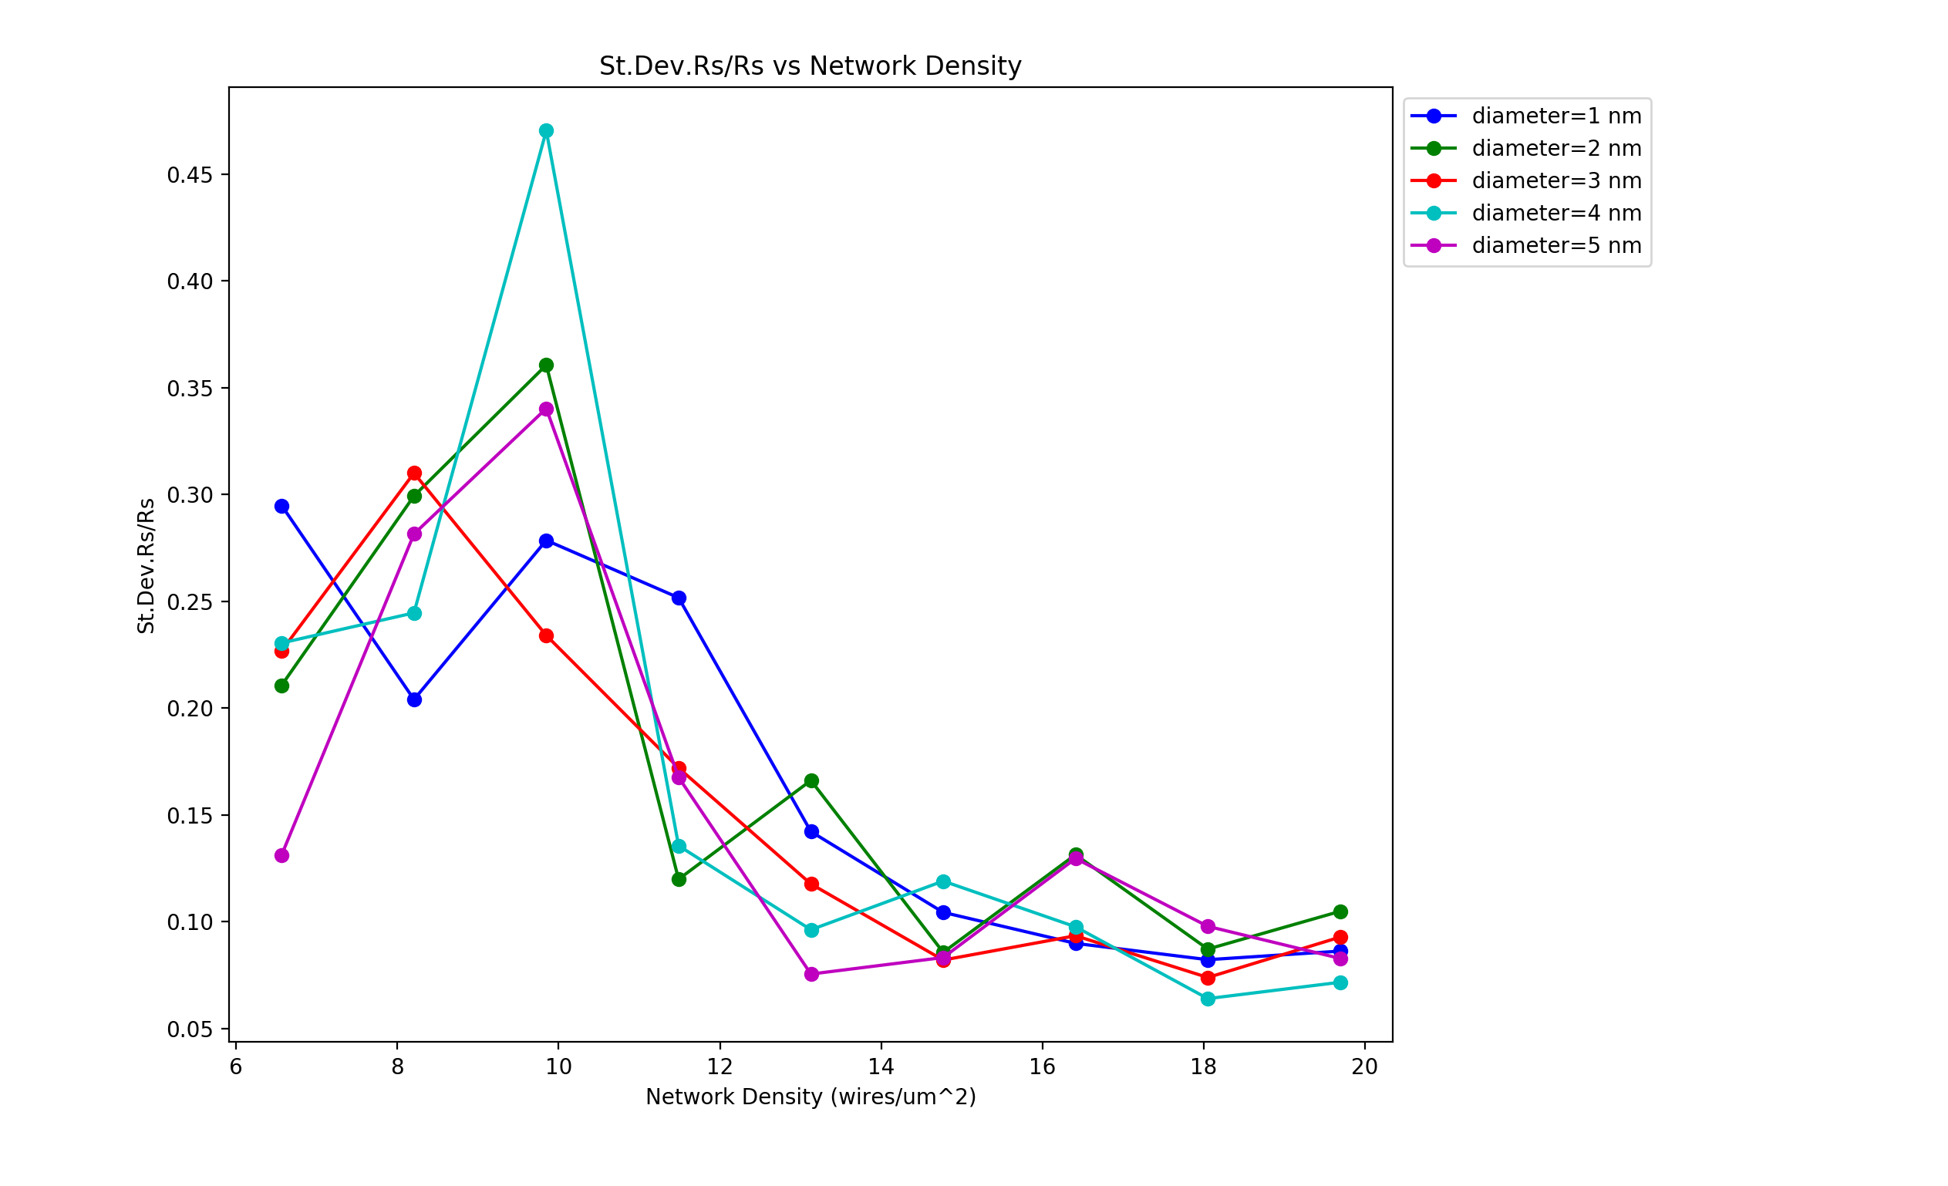
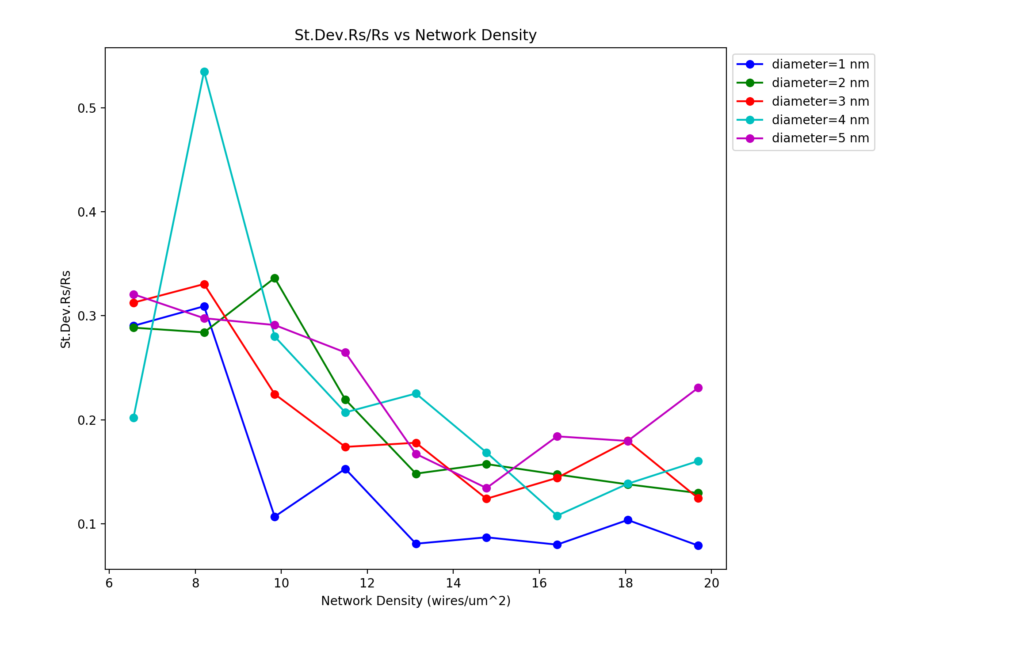
Vary Wire Diameter Constant 𝜌₀ (varying R_{wire} with diameter) Varying 𝜌₀ with diameter (constant R_{wire}≃100kΩ)
Wire diameter: 1nm, Box length: 5um, Rjcn: 1Ω, Samples: 15, uniform wire length,
network density: 6.5644 to 19.6932 in 1.6411 wires/um² steps
Constant 𝜌₀ : 0.0785, Varying 𝜌₀ : 0.314 ·r²

Slide 5
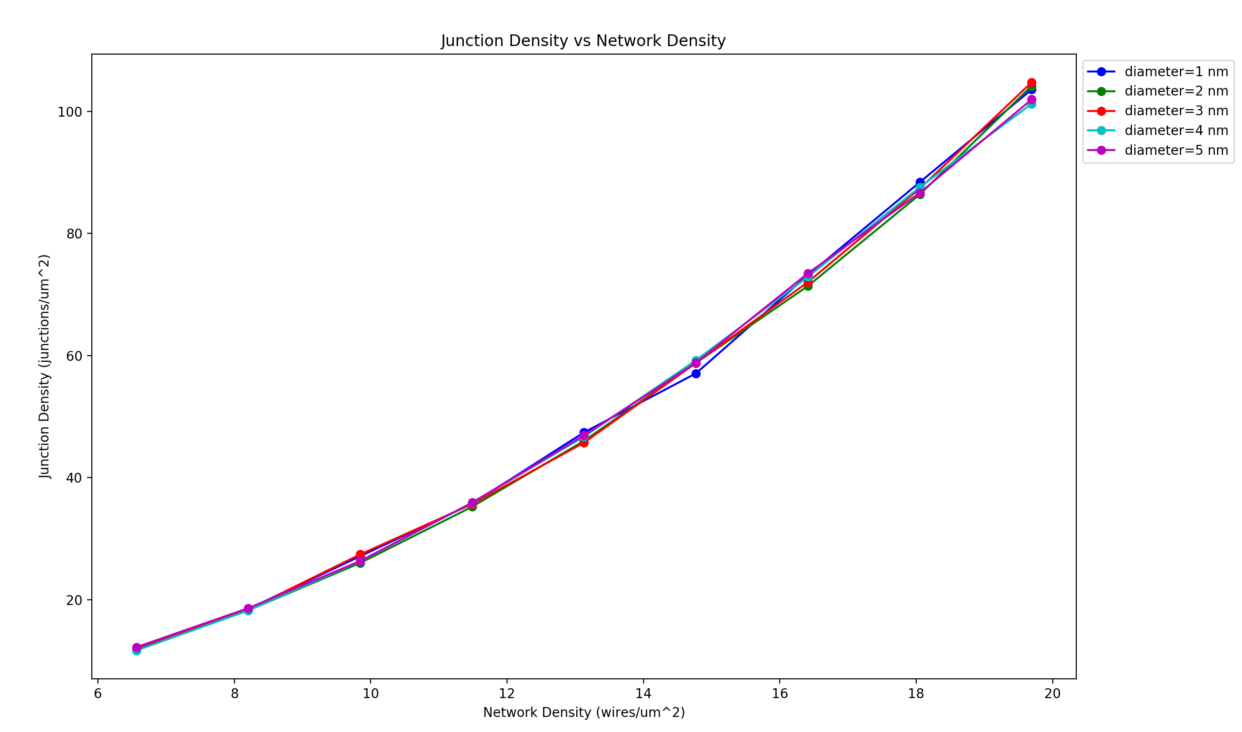
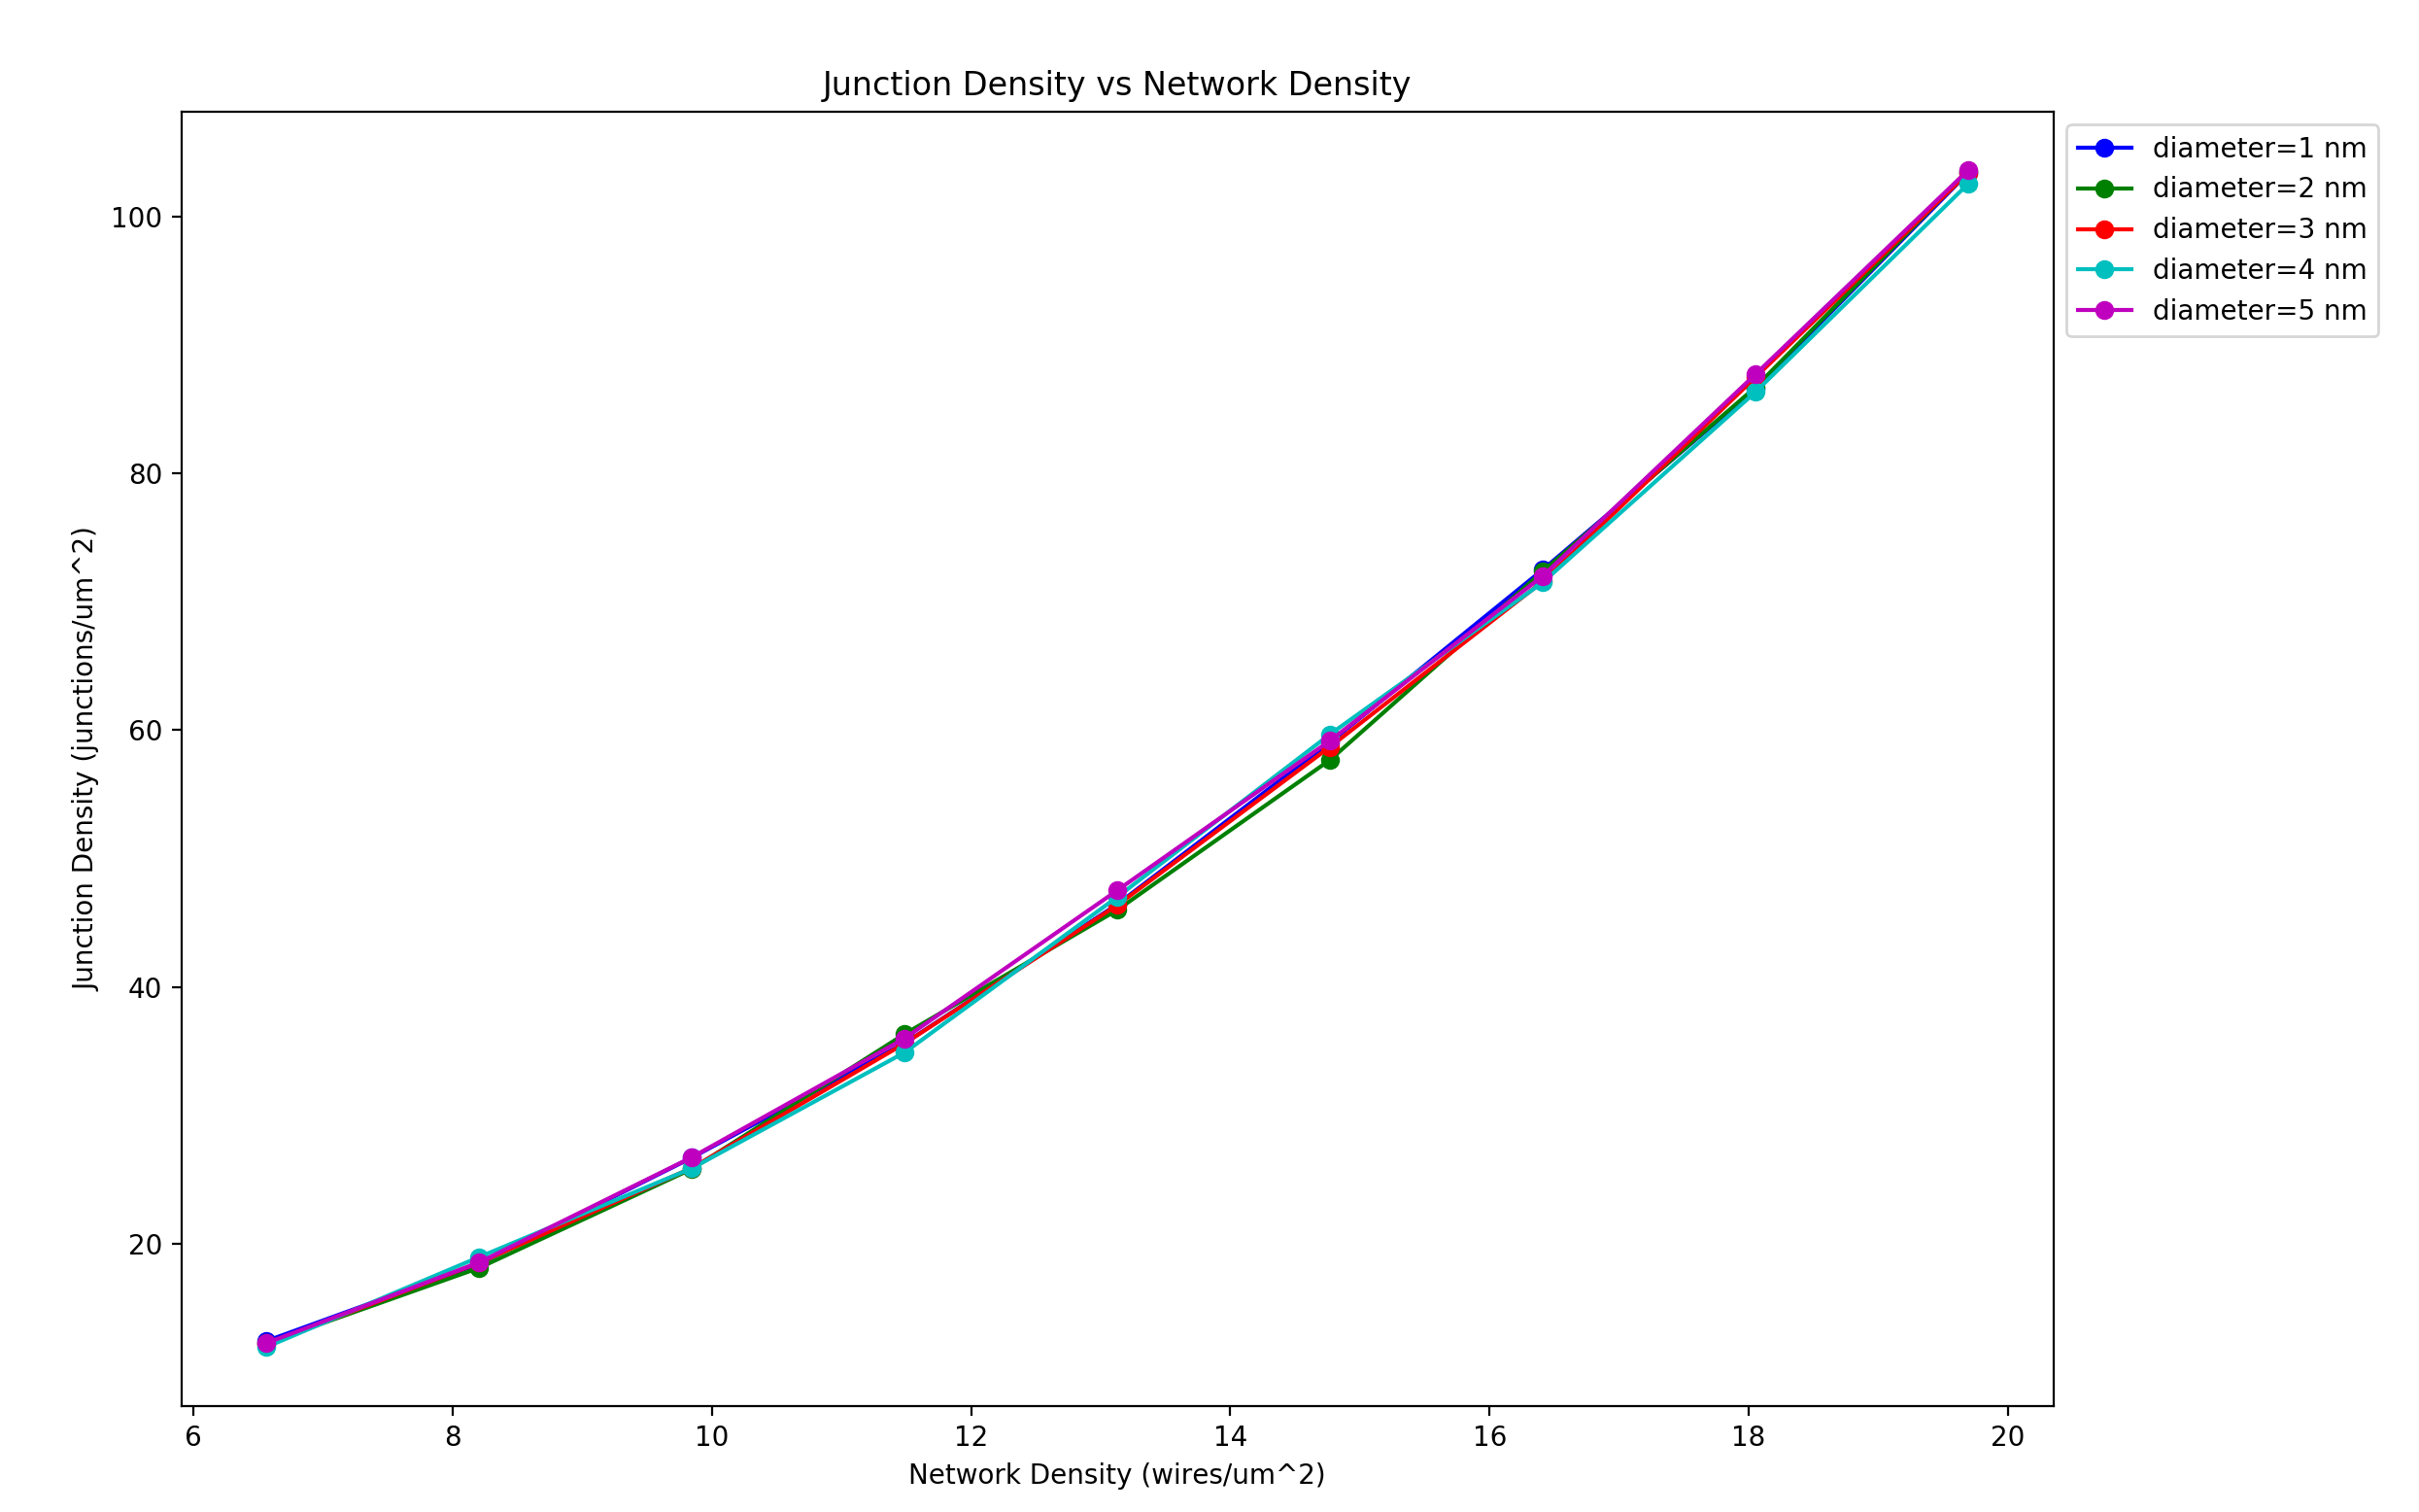
Vary Wire Diameter Constant 𝜌₀ (varying R_{wire} with diameter) Varying 𝜌₀ with diameter (constant R_{wire}≃100kΩ)
Wire diameter: 1nm, Box length: 5um, Rjcn: 1Ω, Samples: 15, uniform wire length,
network density: 6.5644 to 19.6932 in 1.6411 wires/um² steps
Constant 𝜌₀ : 0.0785, Varying 𝜌₀ : 0.314 ·r²

Slide 6
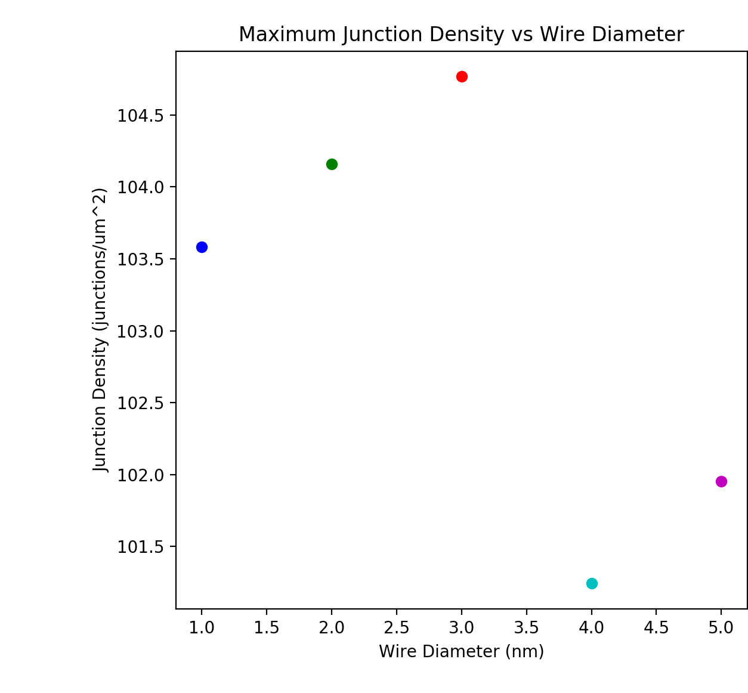
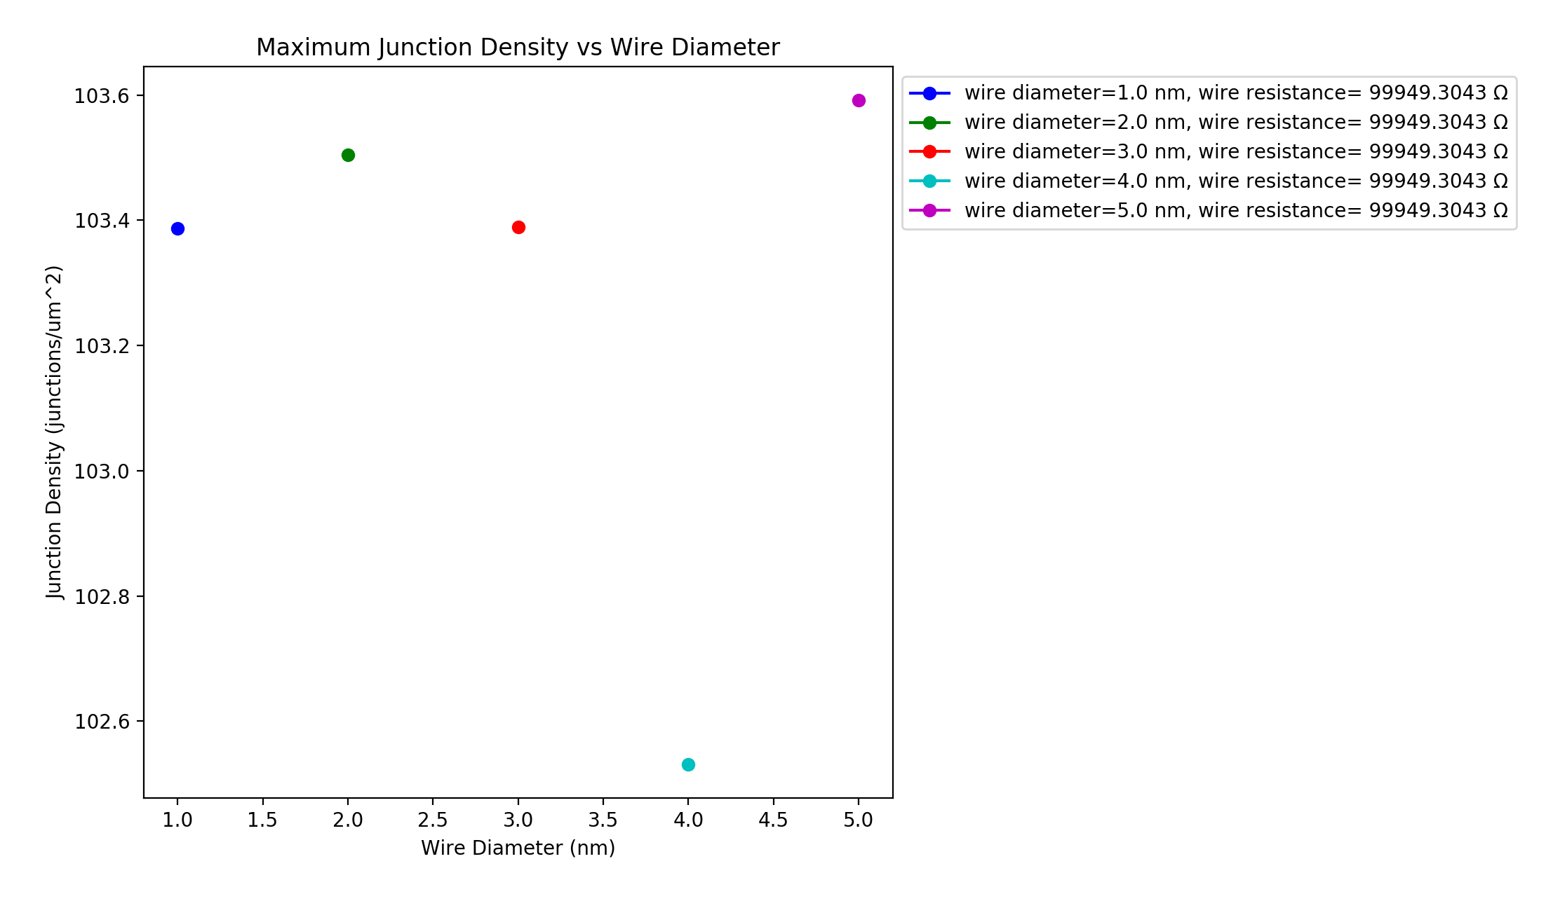
Vary Wire Diameter Constant 𝜌₀ (varying R_{wire} with diameter) Varying 𝜌₀ with diameter (constant R_{wire}≃100kΩ)
Wire diameter: 1nm, Box length: 5um, Rjcn: 1Ω, Samples: 15, uniform wire length,
network density: 6.5644 to 19.6932 in 1.6411 wires/um² steps
Constant 𝜌₀ : 0.0785, Varying 𝜌₀ : 0.314 ·r²

Slide 7
Vary Wire Diameter Constant 𝜌₀ (varying R_{wire} with diameter) Varying 𝜌₀ with diameter (constant R_{wire}≃100kΩ)
Wire diameter: 1nm, Box length: 5um, Rjcn: 1Ω, Samples: 15, uniform wire length,
network density: 6.5644 to 19.6932 in 1.6411 wires/um² steps
Constant 𝜌₀ : 0.0785, Varying 𝜌₀ : 0.314 ·r²

Slide 8
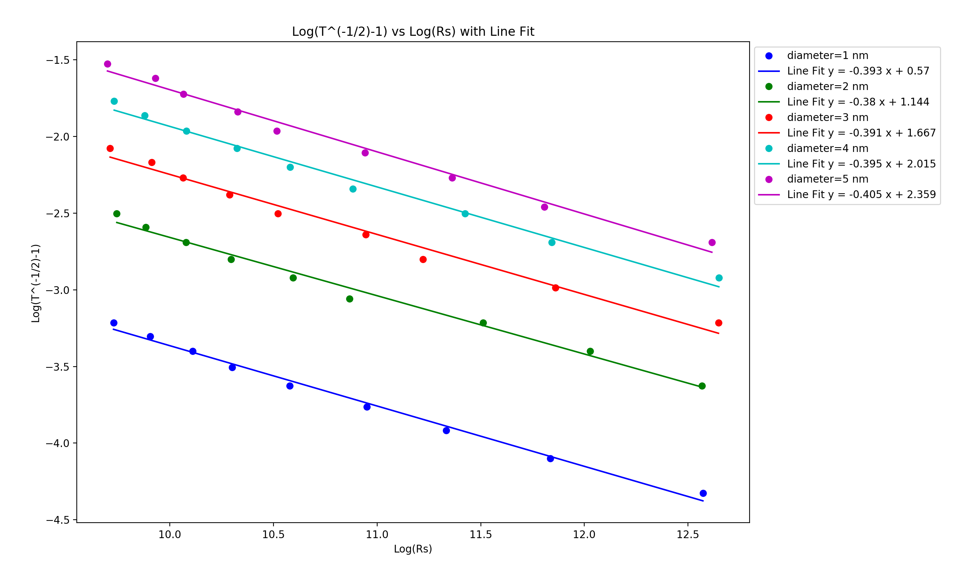
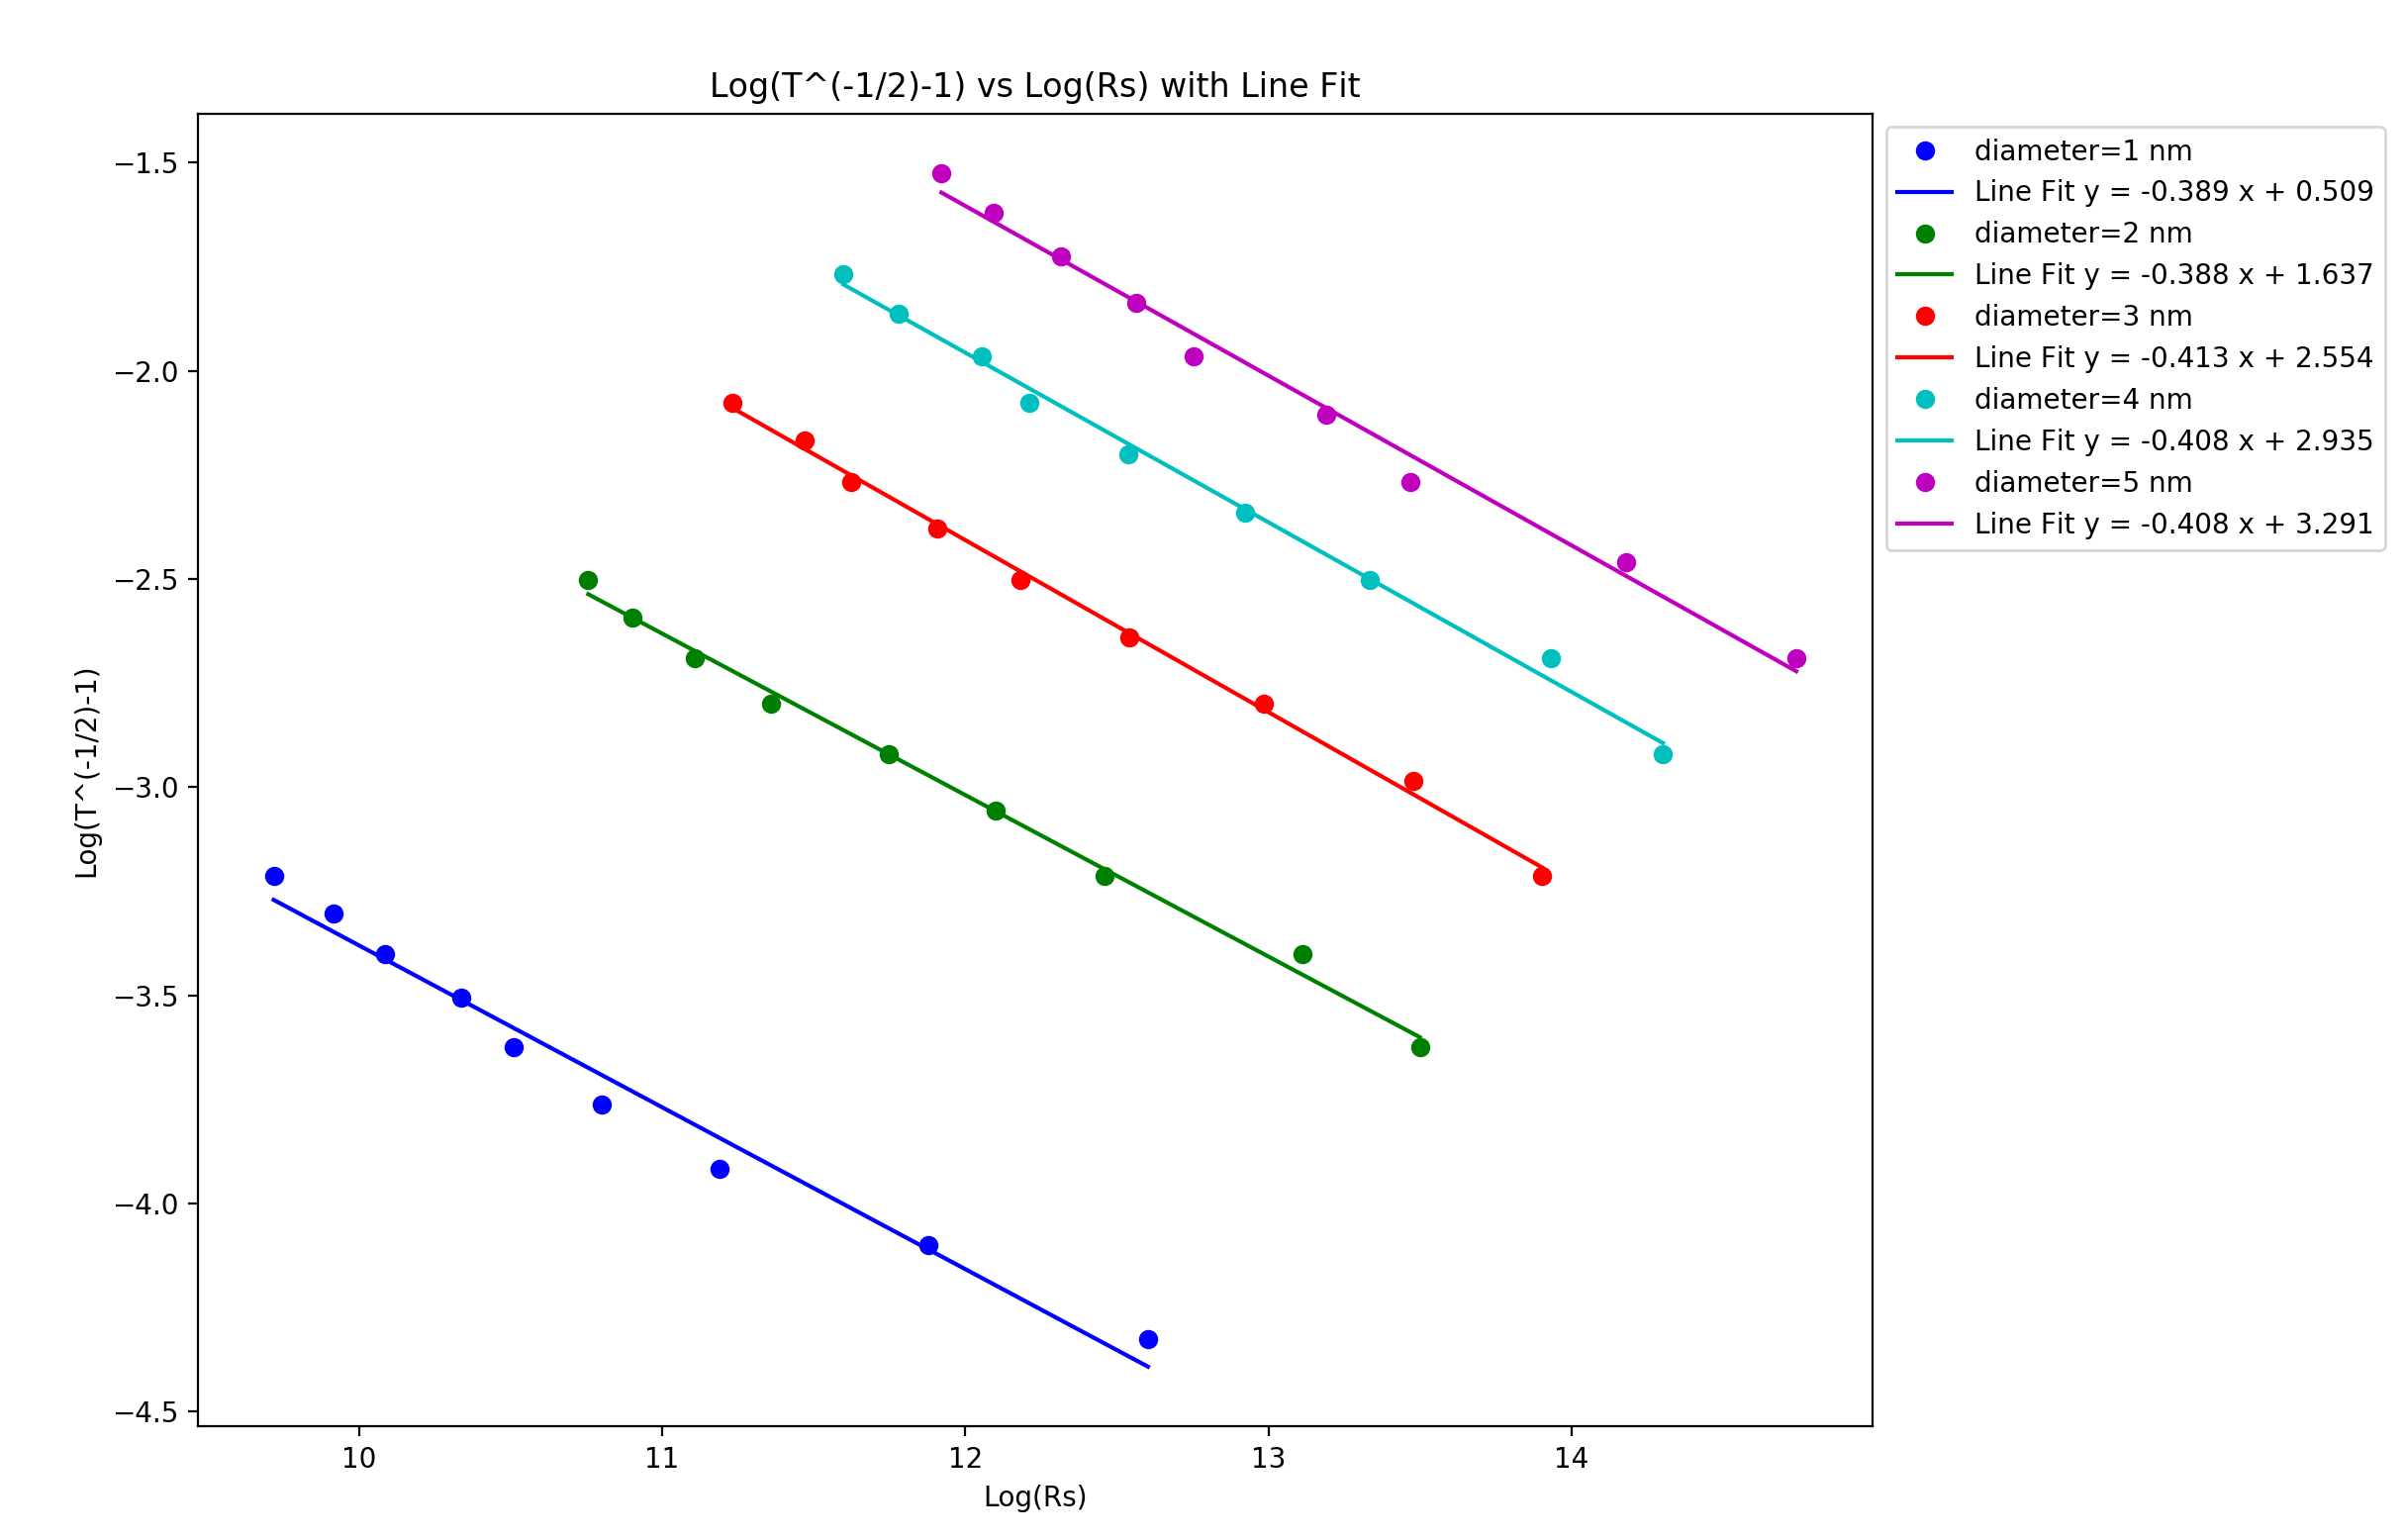
Vary Wire Diameter Constant 𝜌₀ (varying R_{wire} with diameter) Varying 𝜌₀ with diameter (constant R_{wire}≃100kΩ)
Wire diameter: 1nm, Box length: 5um, Rjcn: 1Ω, Samples: 15, uniform wire length,
network density: 6.5644 to 19.6932 in 1.6411 wires/um² steps
Constant 𝜌₀ : 0.0785, Varying 𝜌₀ : 0.314 ·r²

Slide 9
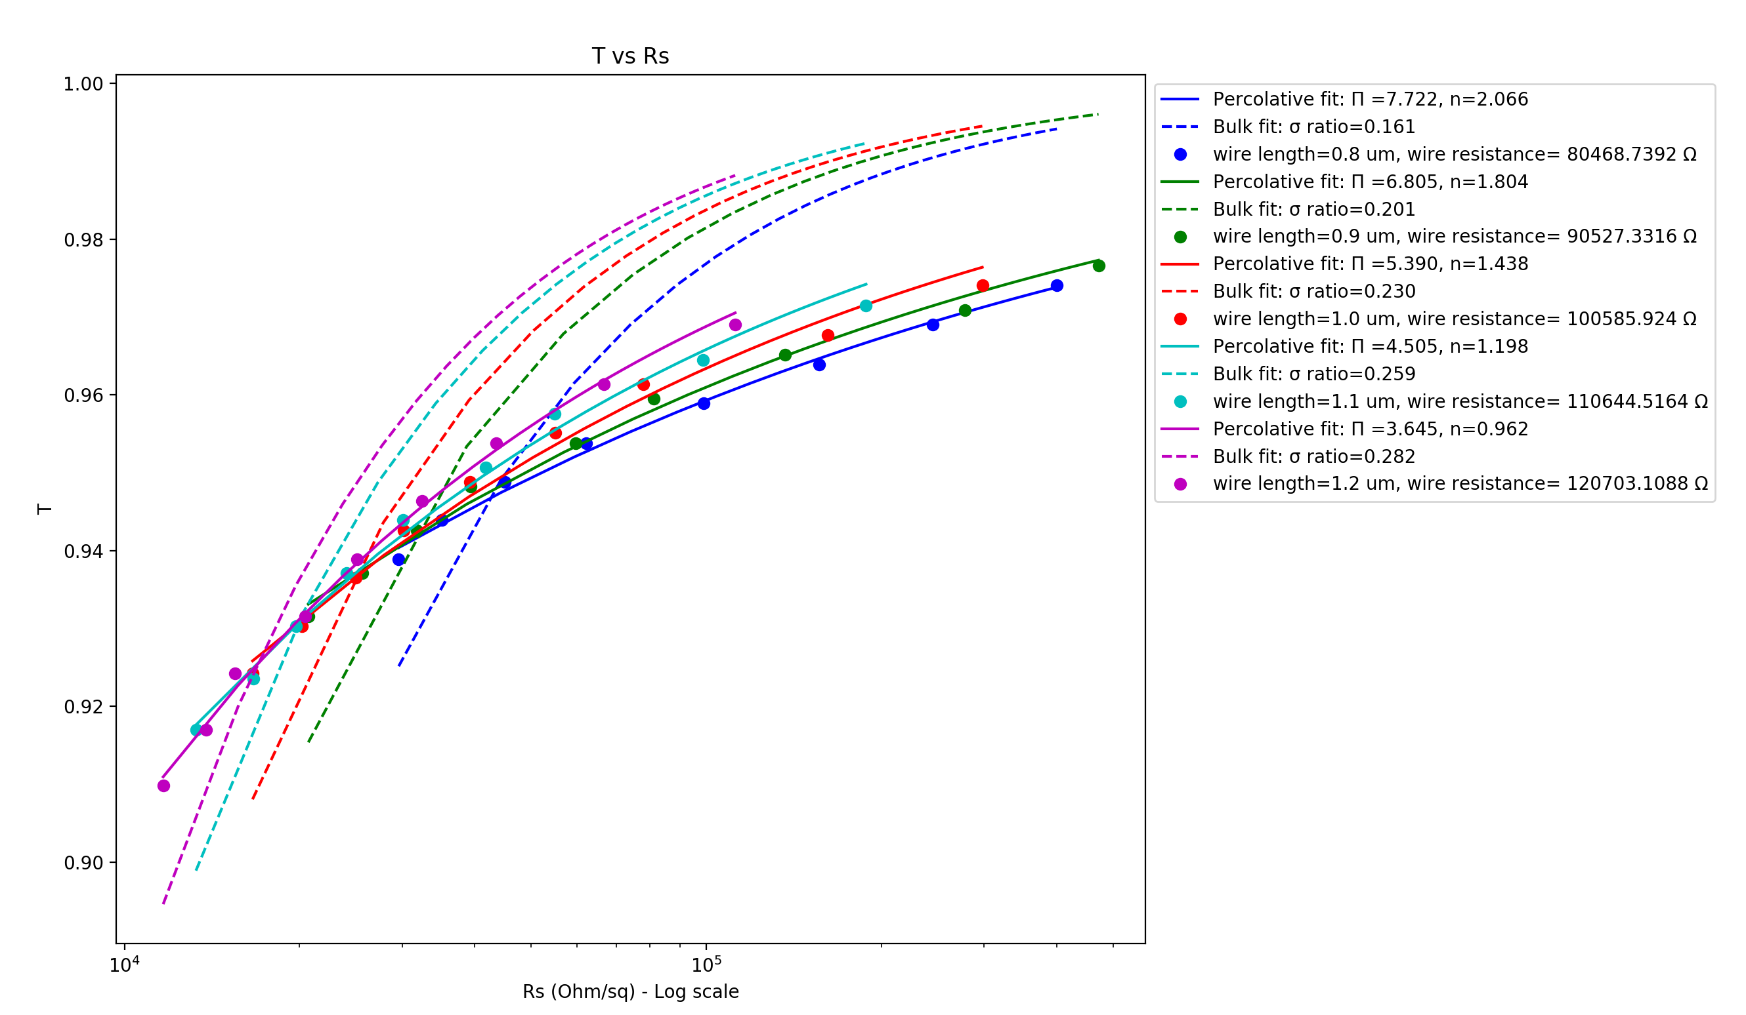
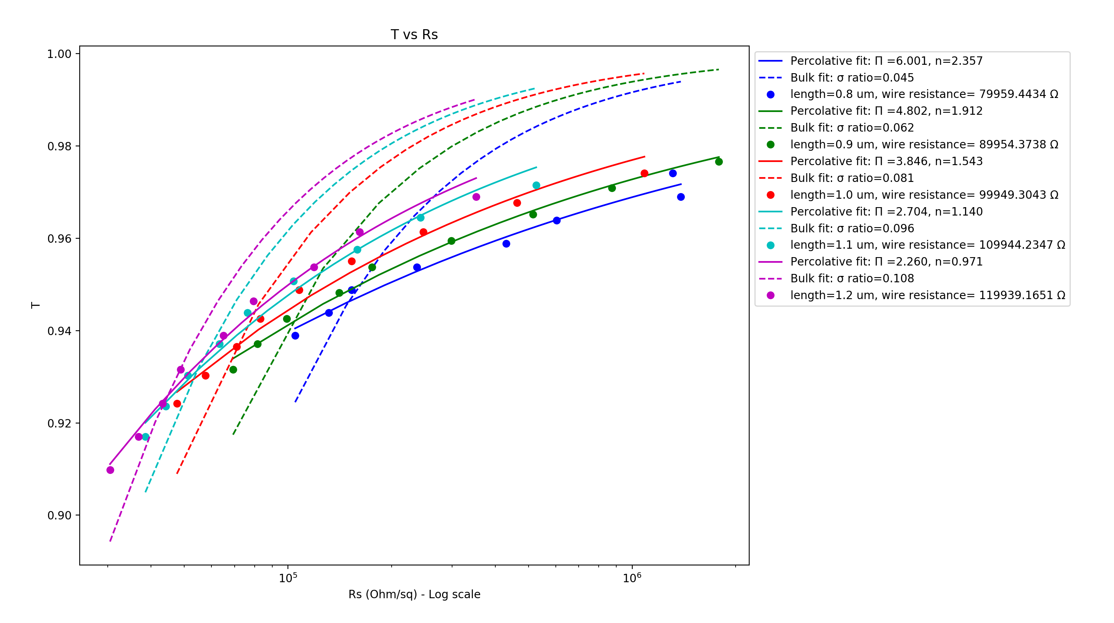
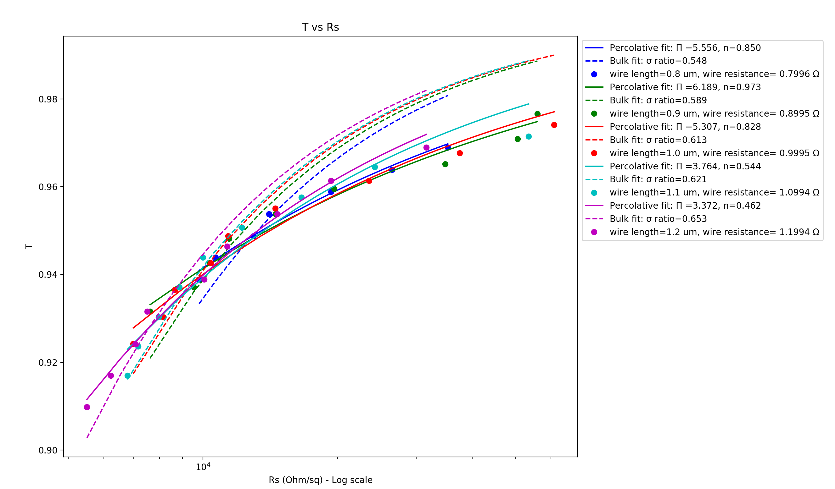
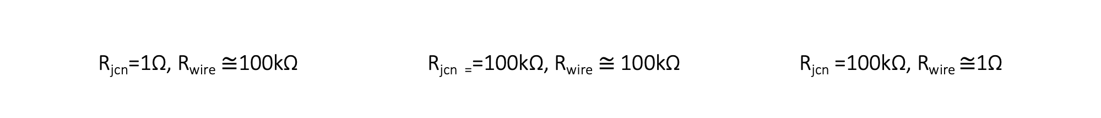
R_{jcn}=1Ω, R_{wire} $≅$100kΩ R_{jcn =}=100kΩ, R_{wire} $≅$100kΩ R_{jcn} =100kΩ, R_{wire} $≅$1Ω
Vary Wire Length – 0.8-1.2 um (0.1um steps)
Wire diameter: 1nm, Box length: 5um, Samples: 15, 𝜌₀ constant, uniform wire length,
network density: 6.5644 to 19.6932 in 1.6411 wires/um² steps

Slide 10
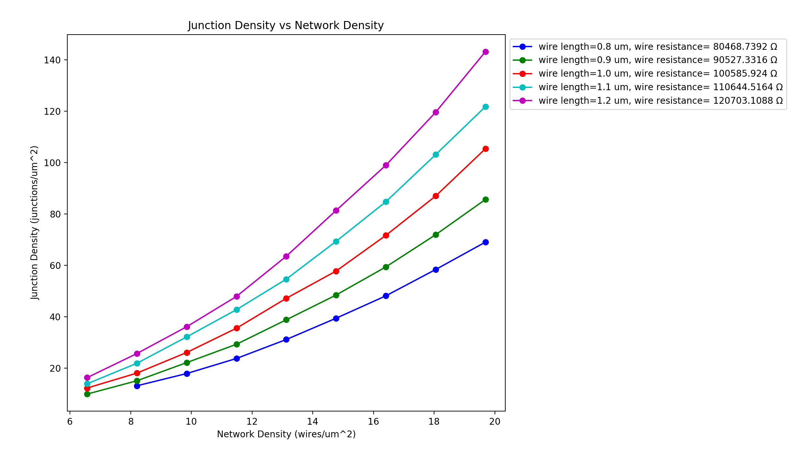
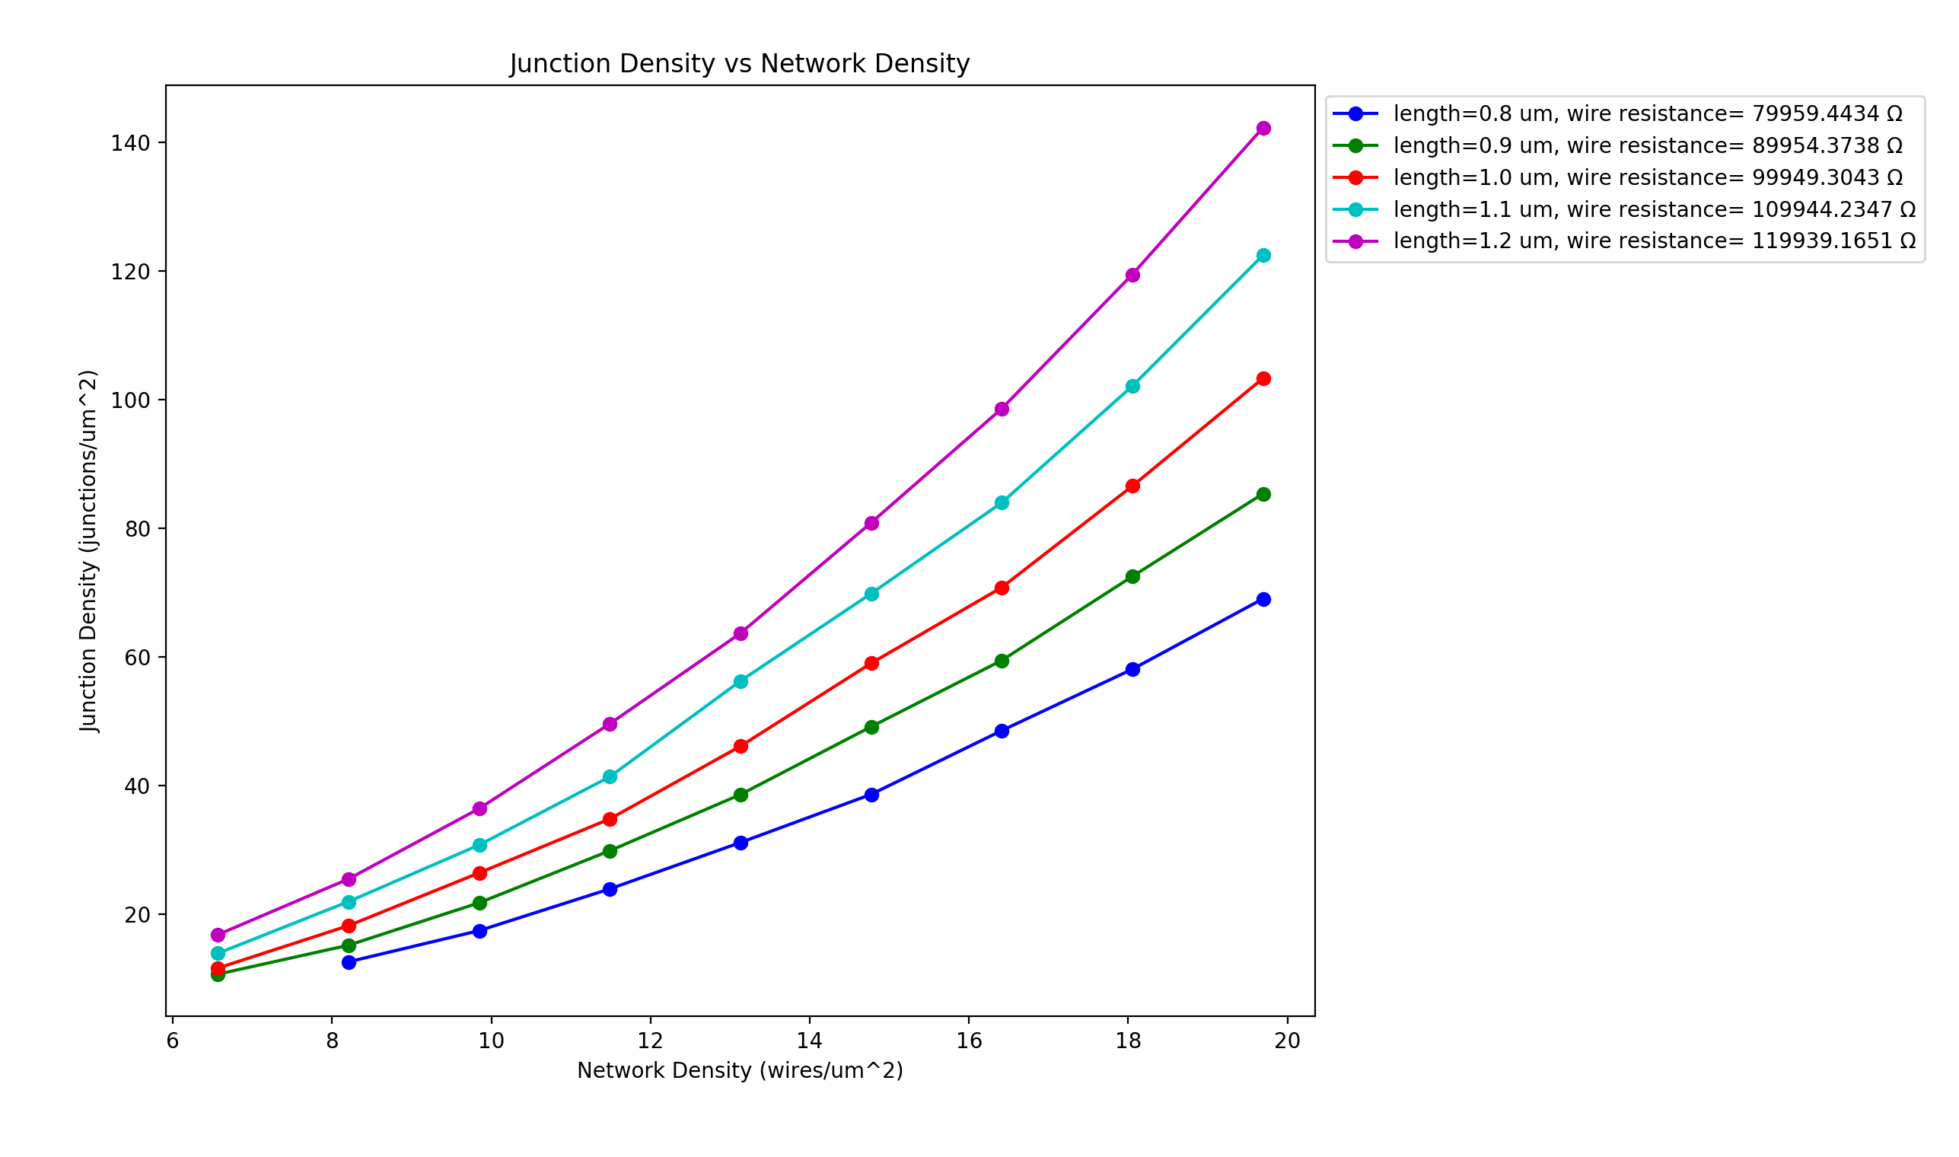
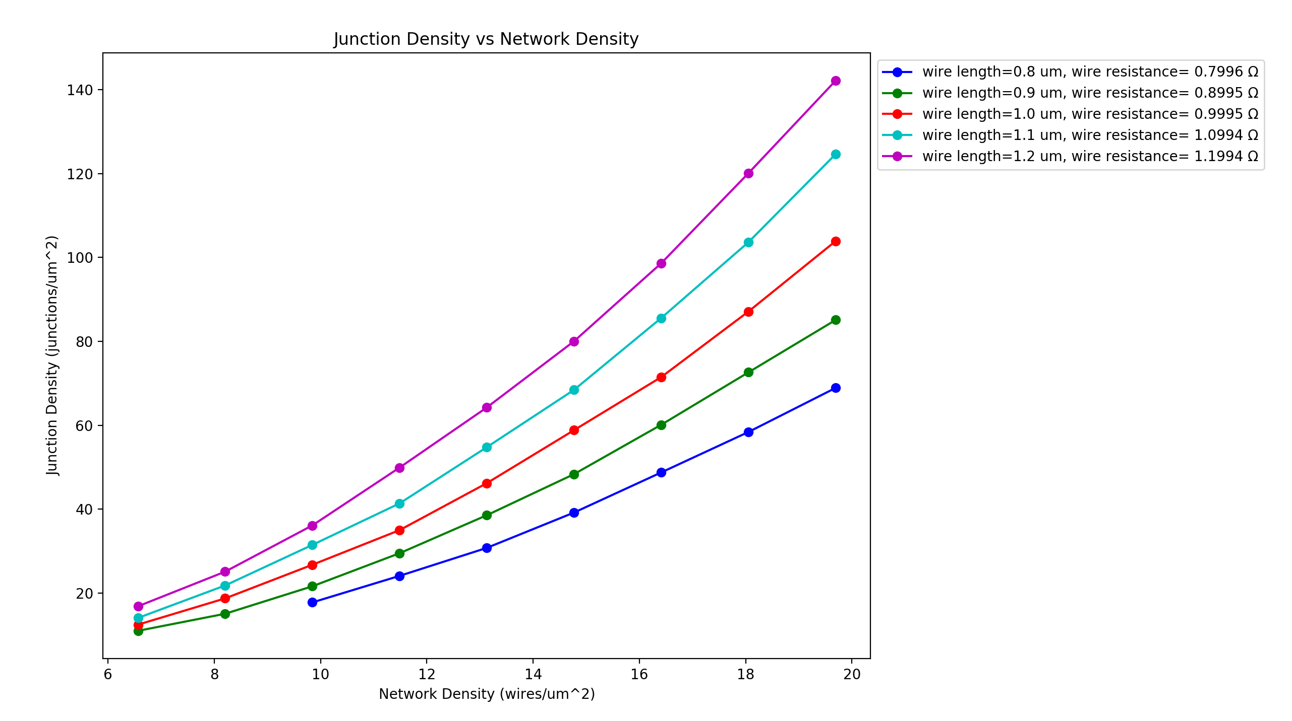
R_{jcn}=1Ω, R_{wire} $≅$100kΩ R_{jcn =}=100kΩ, R_{wire} $≅$100kΩ R_{jcn} =100kΩ, R_{wire} $≅$1Ω
Vary Wire Length – 0.8-1.2 um (0.1um steps)
Wire diameter: 1nm, Box length: 5um, Samples: 15, 𝜌₀ constant, uniform wire length,
network density: 6.5644 to 19.6932 in 1.6411 wires/um² steps

Slide 11
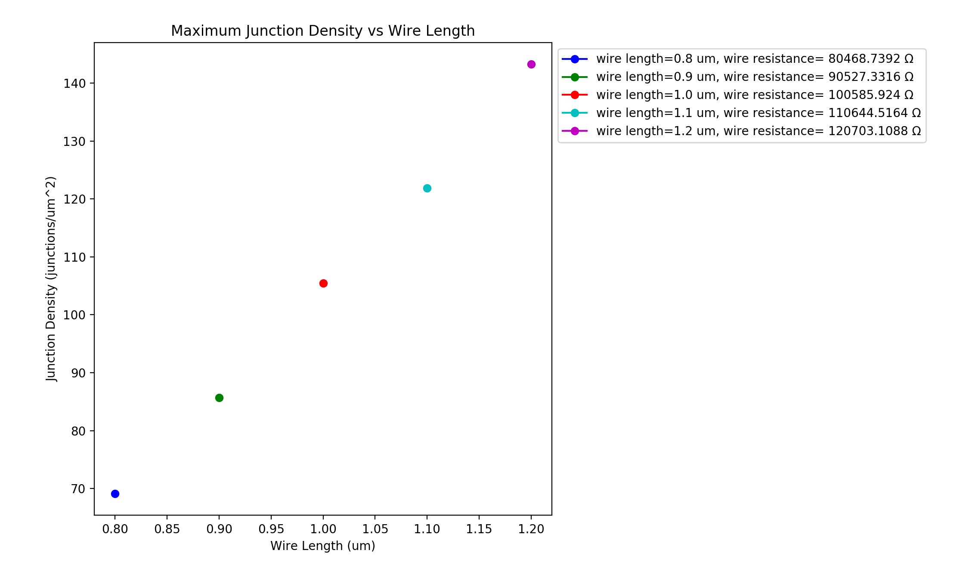
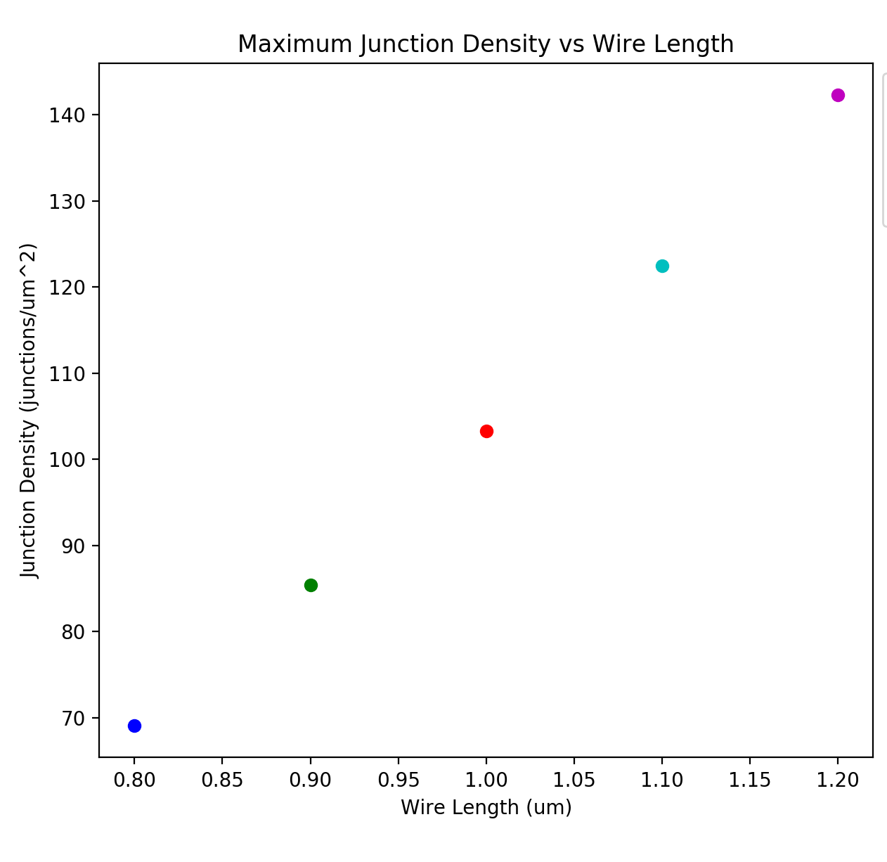
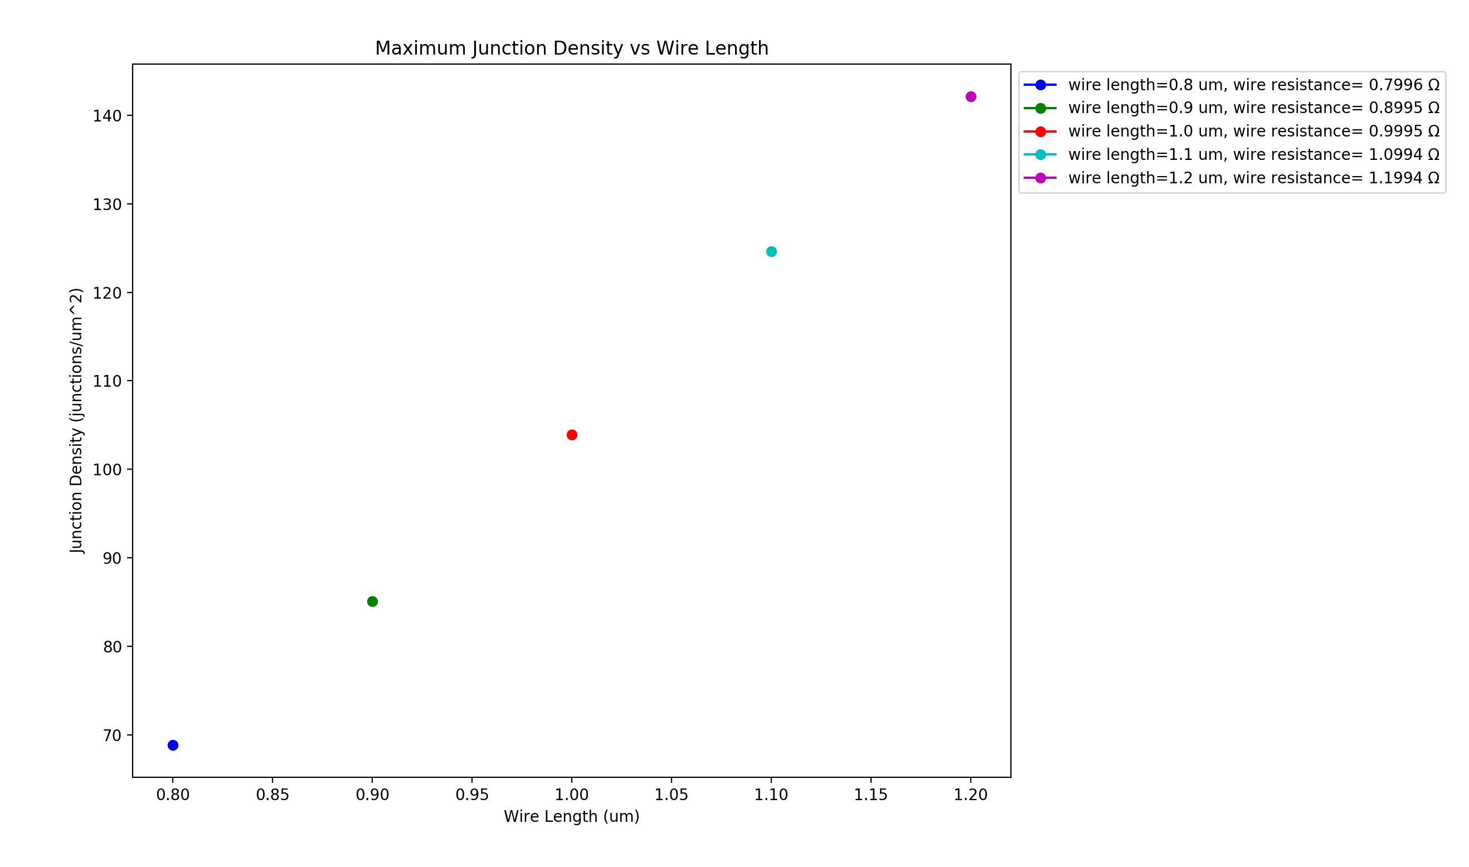
R_{jcn}=1Ω, R_{wire} $≅$100kΩ R_{jcn =}=100kΩ, R_{wire} $≅$100kΩ R_{jcn} =100kΩ, R_{wire} $≅$1Ω
Vary Wire Length – 0.8-1.2 um (0.1um steps)
Wire diameter: 1nm, Box length: 5um, Samples: 15, 𝜌₀ constant, uniform wire length,
network density: 6.5644 to 19.6932 in 1.6411 wires/um² steps

Slide 12
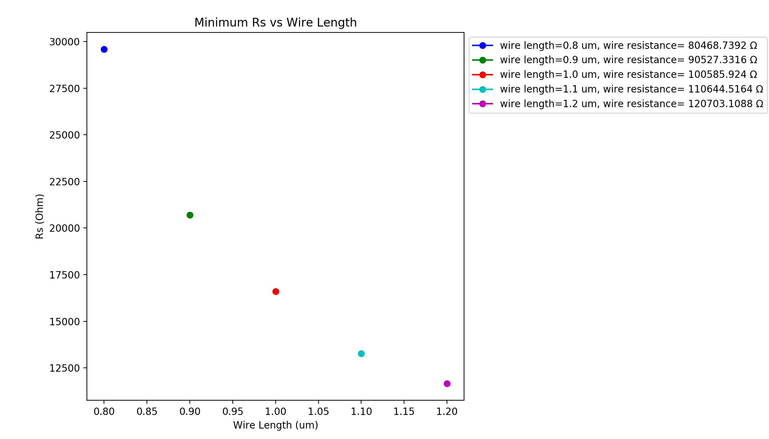
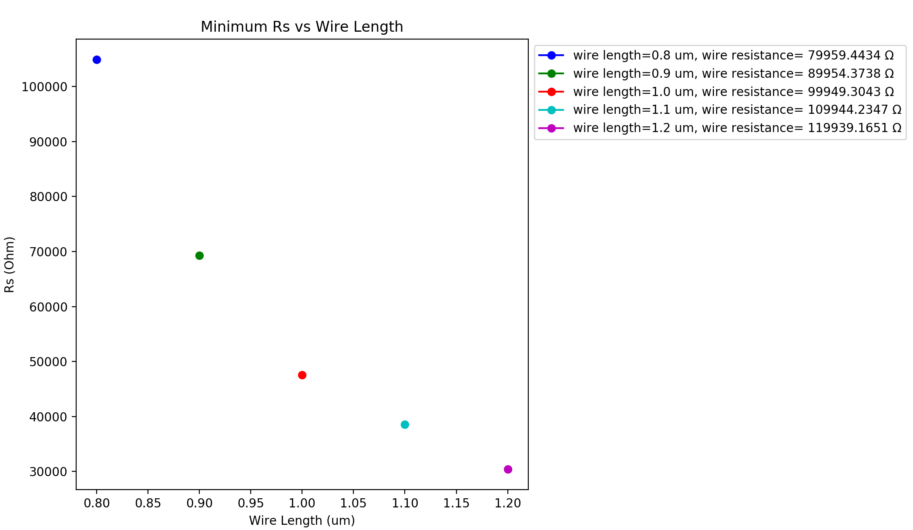
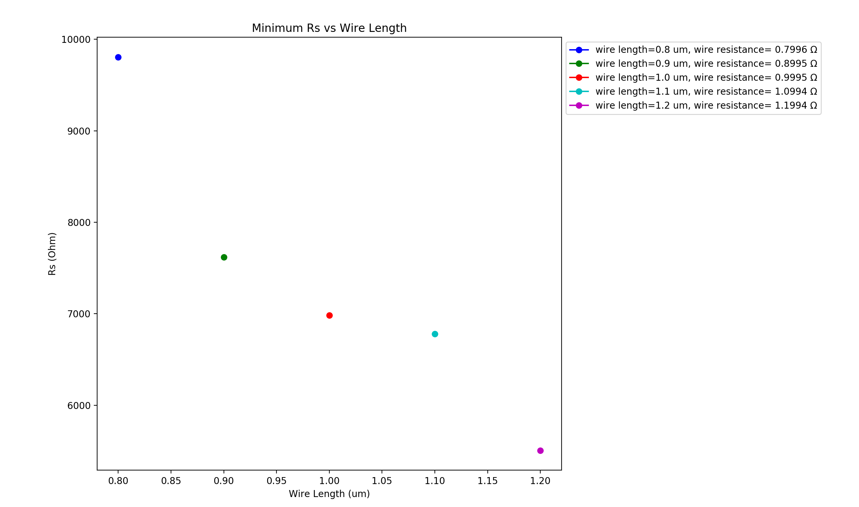
R_{jcn}=1Ω, R_{wire} $≅$100kΩ R_{jcn =}=100kΩ, R_{wire} $≅$100kΩ R_{jcn} =100kΩ, R_{wire} $≅$1Ω
Vary Wire Length – 0.8-1.2 um (0.1um steps)
Wire diameter: 1nm, Box length: 5um, Samples: 15, 𝜌₀ constant, uniform wire length,
network density: 6.5644 to 19.6932 in 1.6411 wires/um² steps

Slide 13
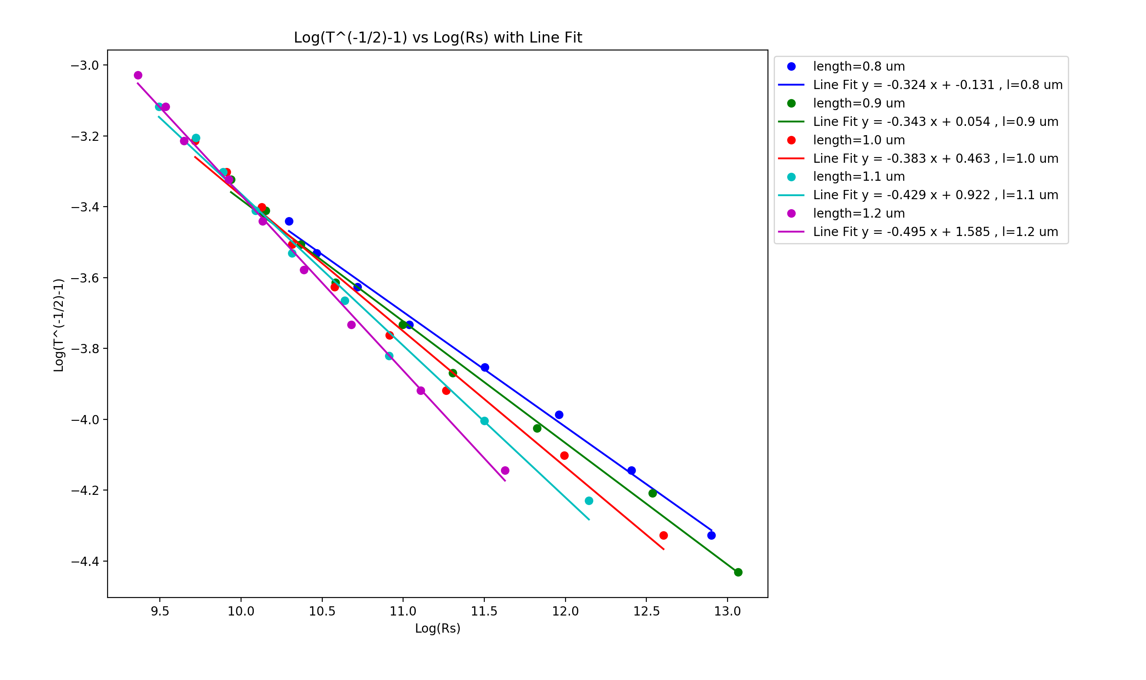
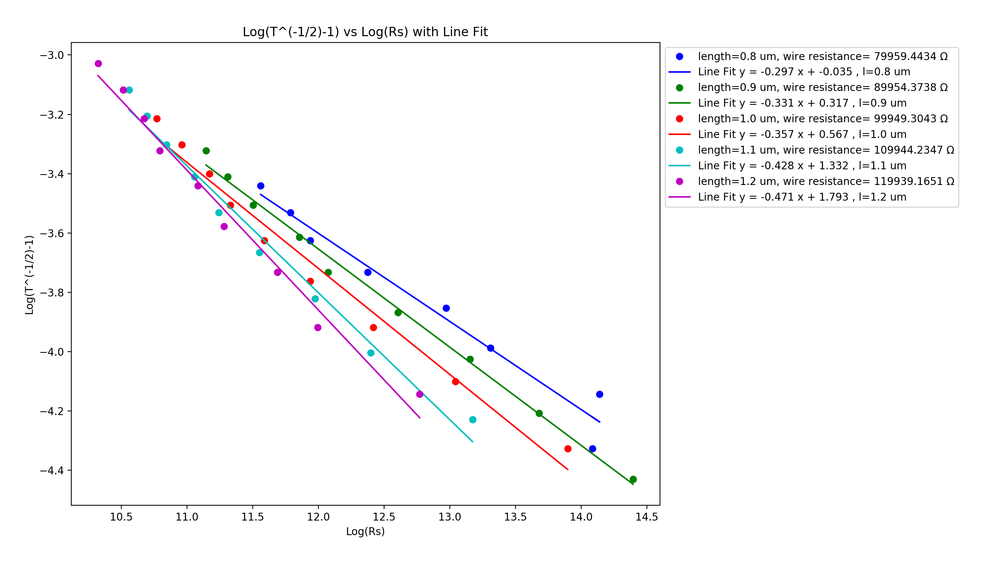
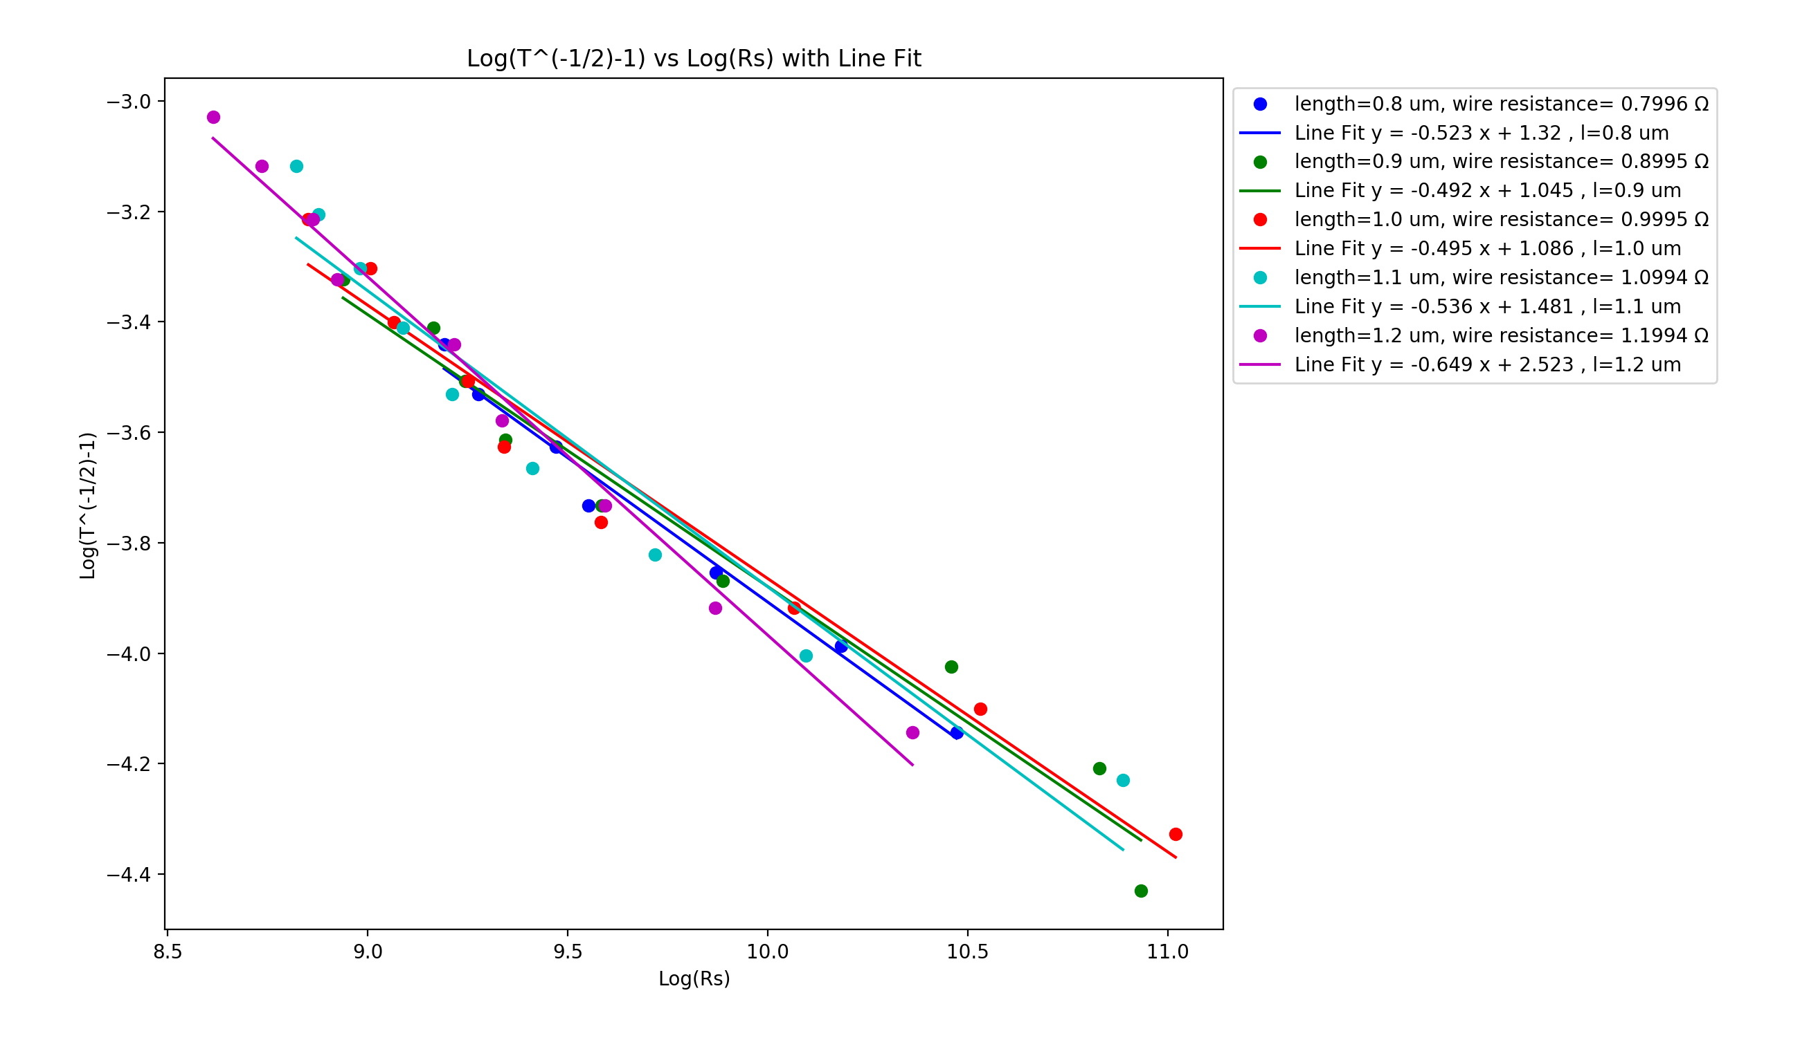
R_{jcn}=1Ω, R_{wire} $≅$100kΩ R_{jcn =}=100kΩ, R_{wire} $≅$100kΩ R_{jcn} =100kΩ, R_{wire} $≅$1Ω
Vary Wire Length – 0.8-1.2 um (0.1um steps)
Wire diameter: 1nm, Box length: 5um, Samples: 15, 𝜌₀ constant, uniform wire length,
network density: 6.5644 to 19.6932 in 1.6411 wires/um² steps

Slide 14
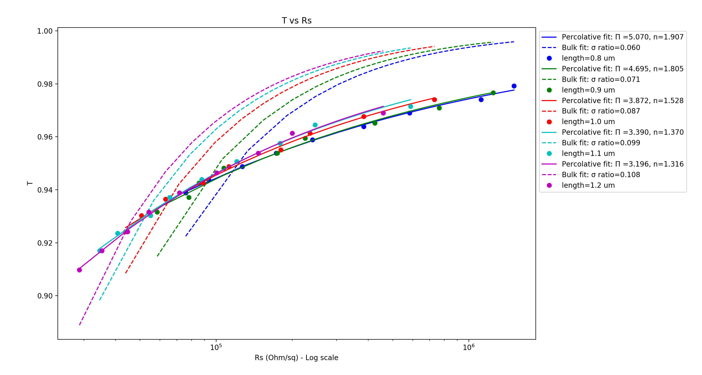
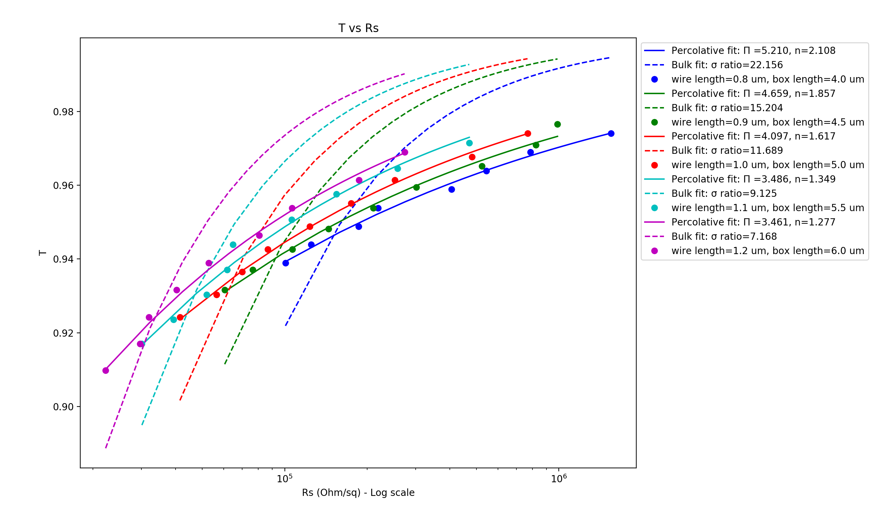
Vary Wire Length – 0.8-1.2 um (0.1um steps) Fixed Box Size (5um) Box Size = 5 x Wire Length
Wire diameter: 1nm, Rjcn: 1Ω, Rwire ≃400kΩ, Samples: 15, uniform wire length,
network density: 6.5644 to 19.6932 in 1.6411 wires/um² steps

Slide 15
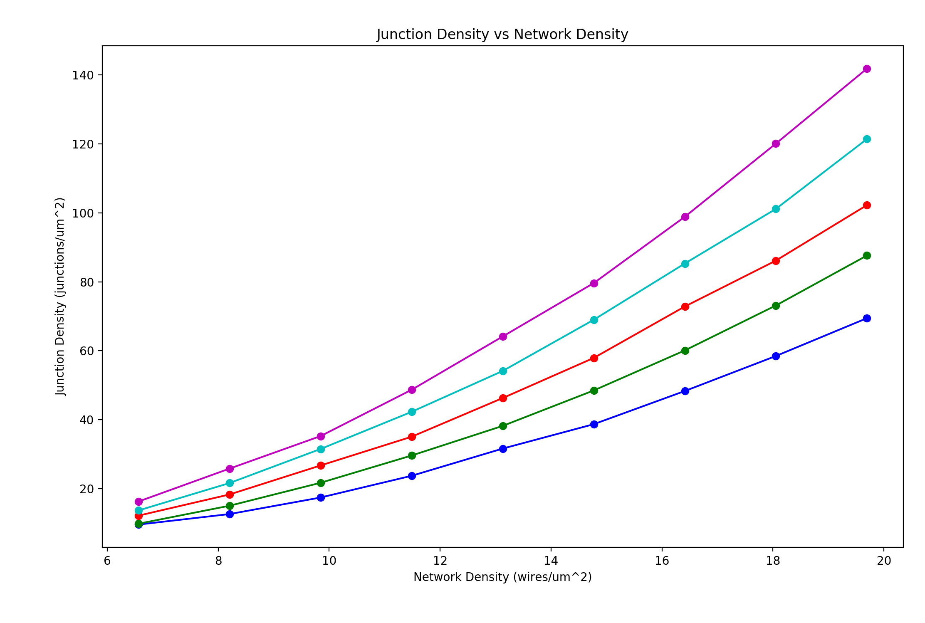
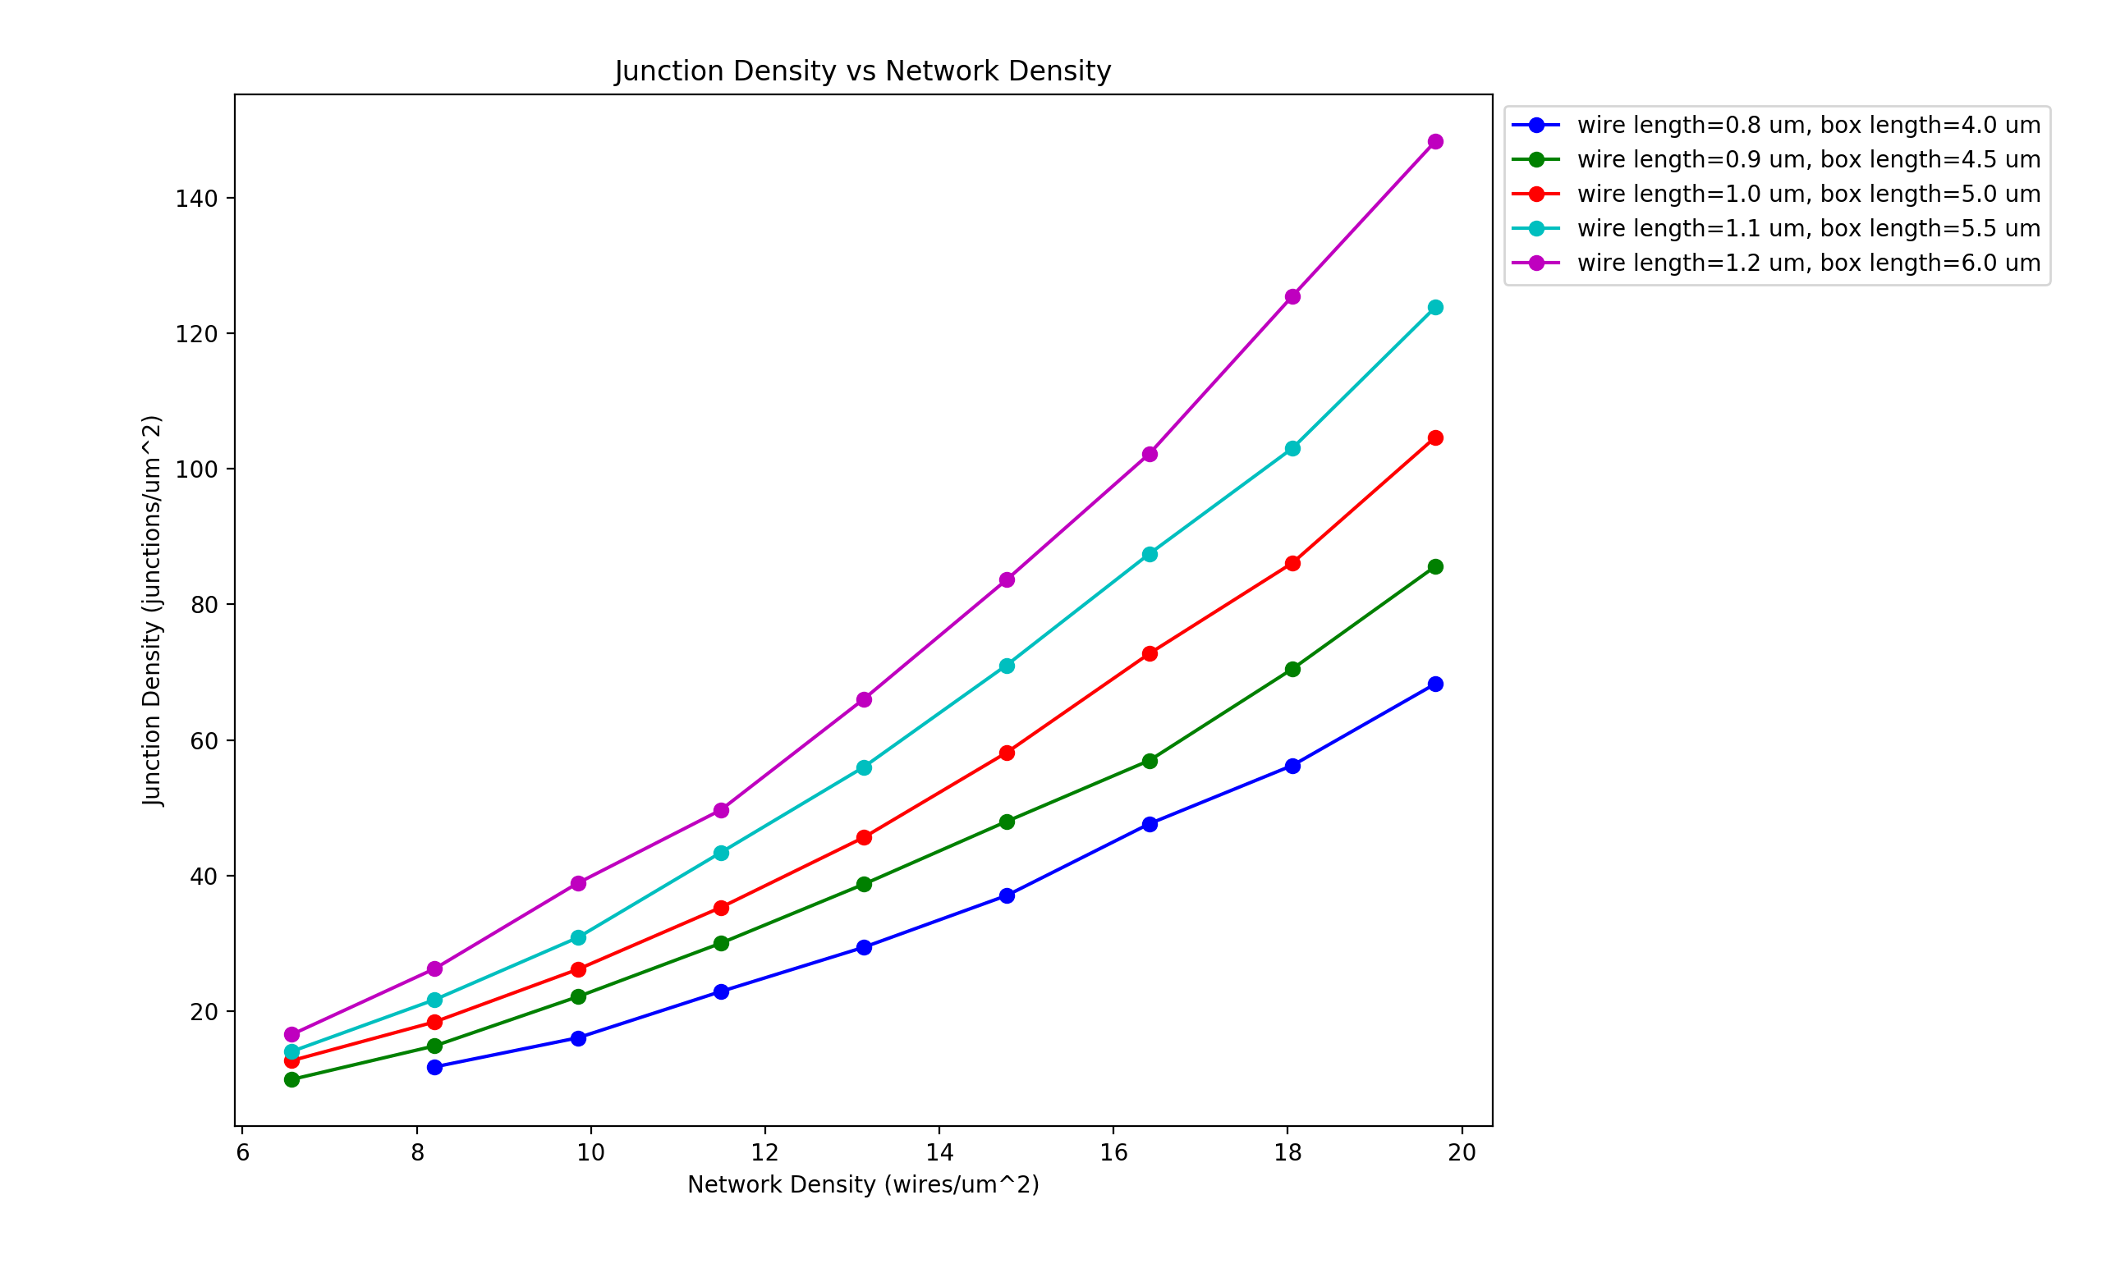
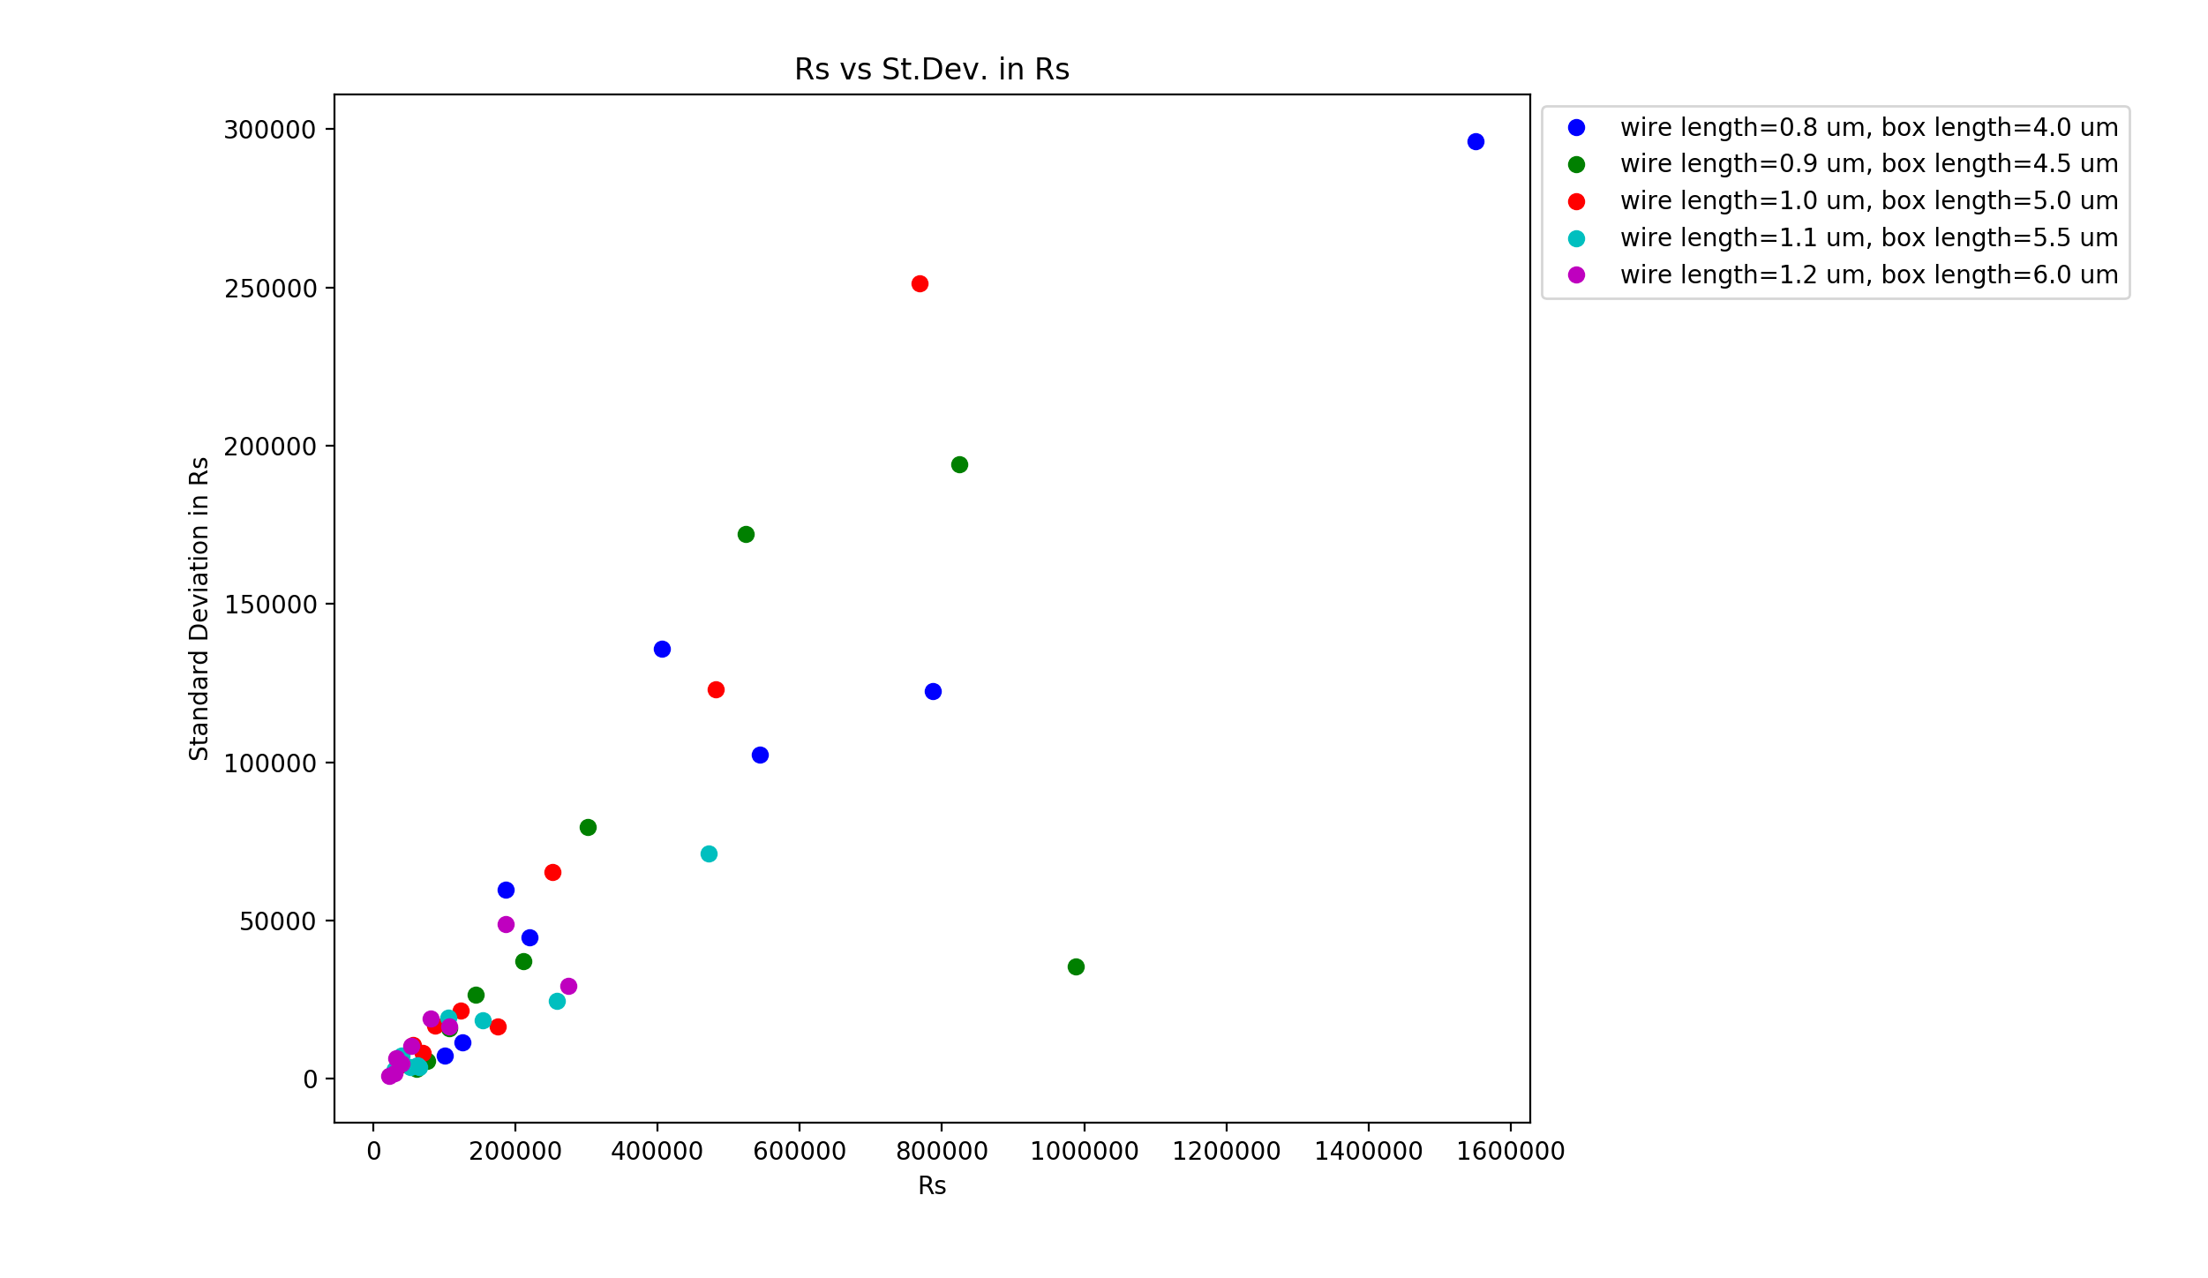
Vary Wire Length – 0.8-1.2 um (0.1um steps) Fixed Box Size (5um) Box Size = 5 x Wire Length
Wire diameter: 1nm, Rjcn: 1Ω, Rwire ≃400kΩ, Samples: 15, uniform wire length,
network density: 6.5644 to 19.6932 in 1.6411 wires/um² steps

Slide 16
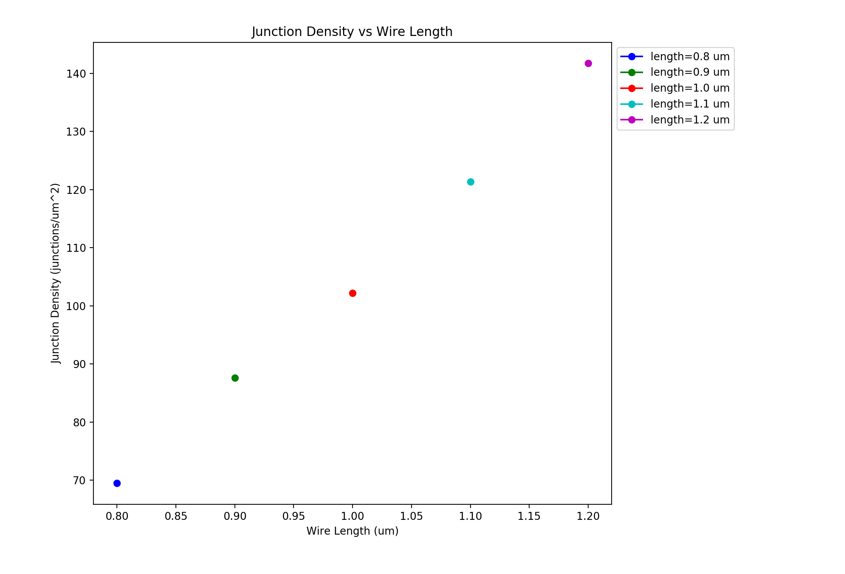
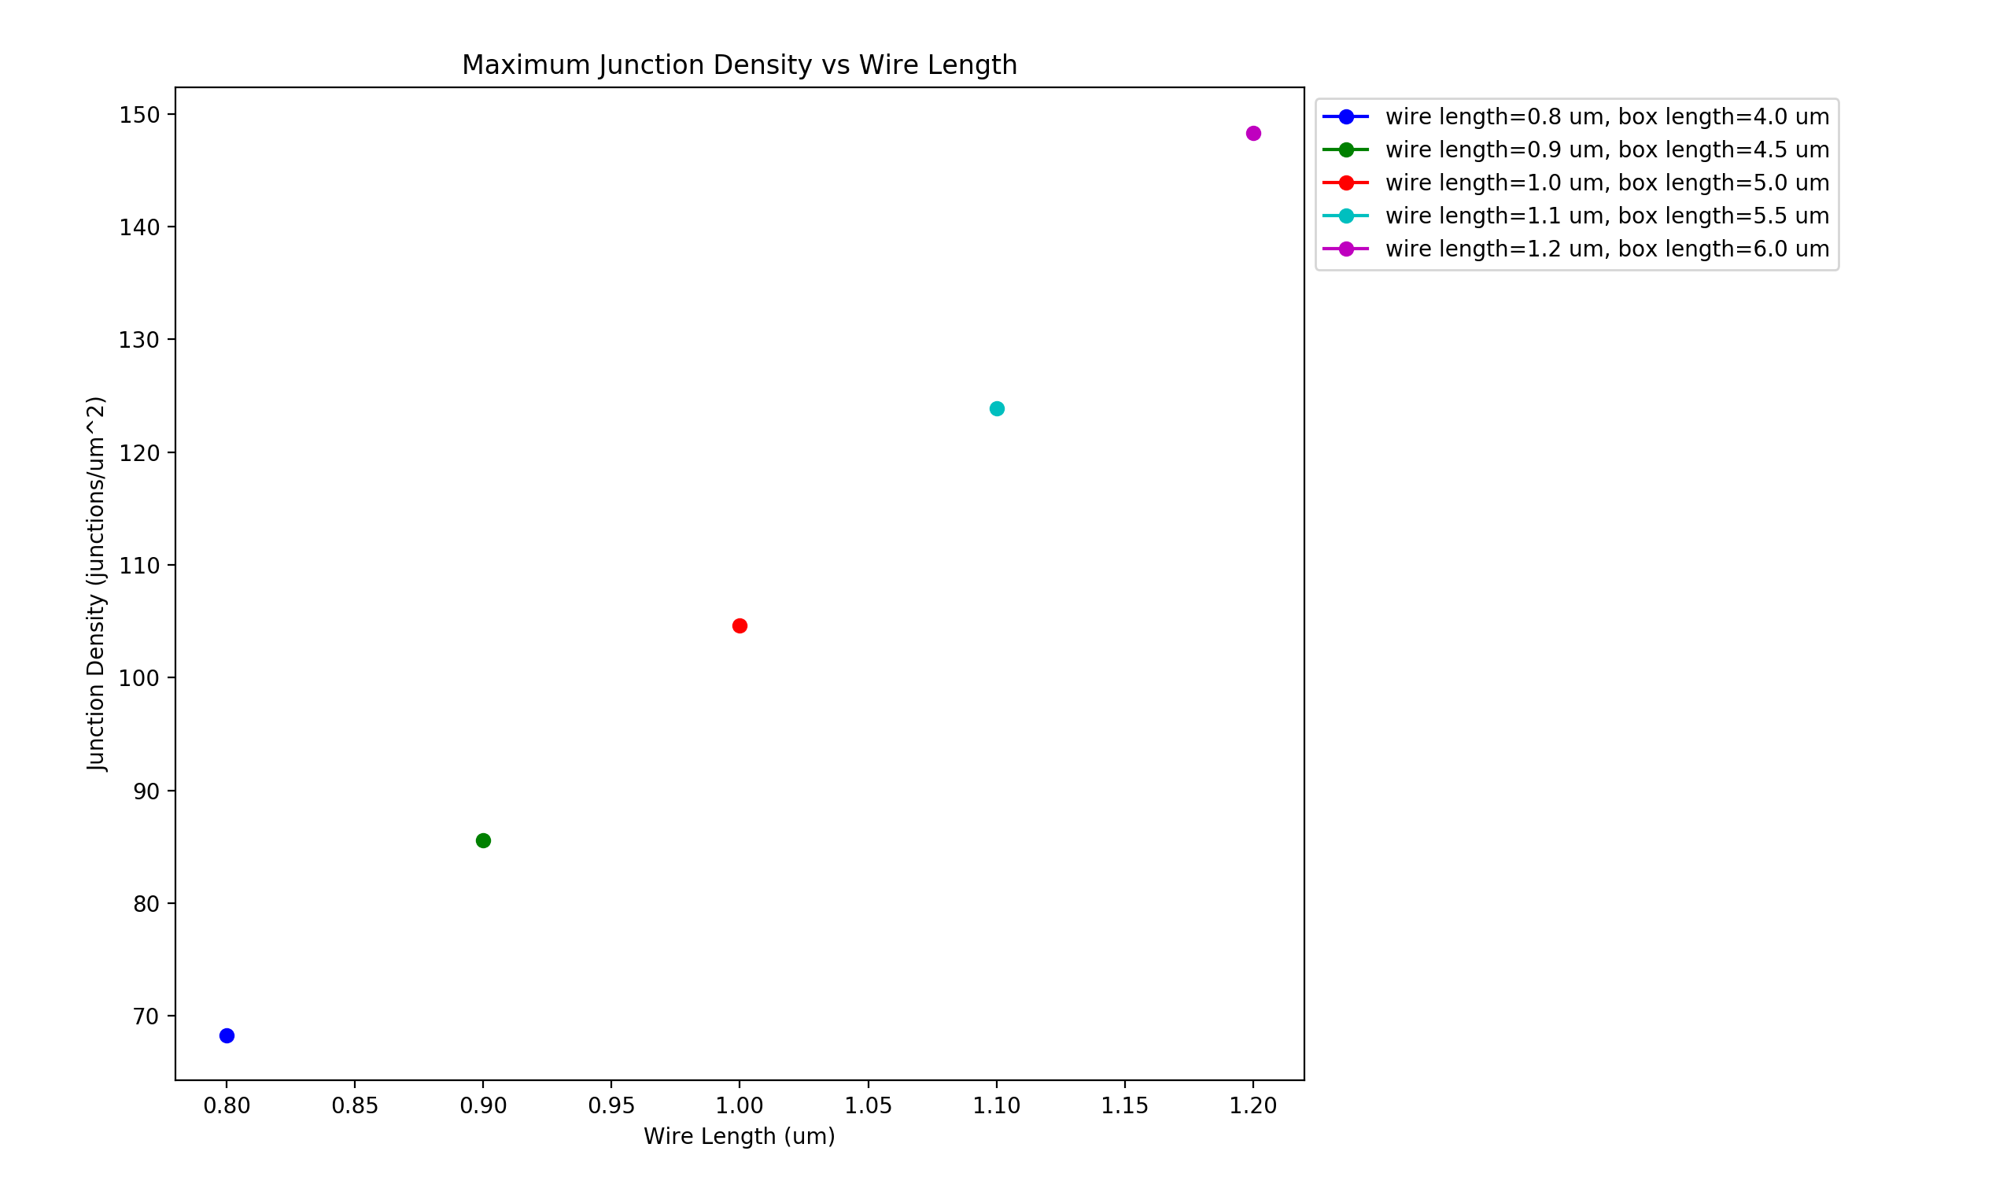
Vary Wire Length – 0.8-1.2 um (0.1um steps) Fixed Box Size (5um) Box Size = 5 x Wire Length
Wire diameter: 1nm, Rjcn: 1Ω, Rwire ≃400kΩ, Samples: 15, uniform wire length,
network density: 6.5644 to 19.6932 in 1.6411 wires/um² steps

Slide 17
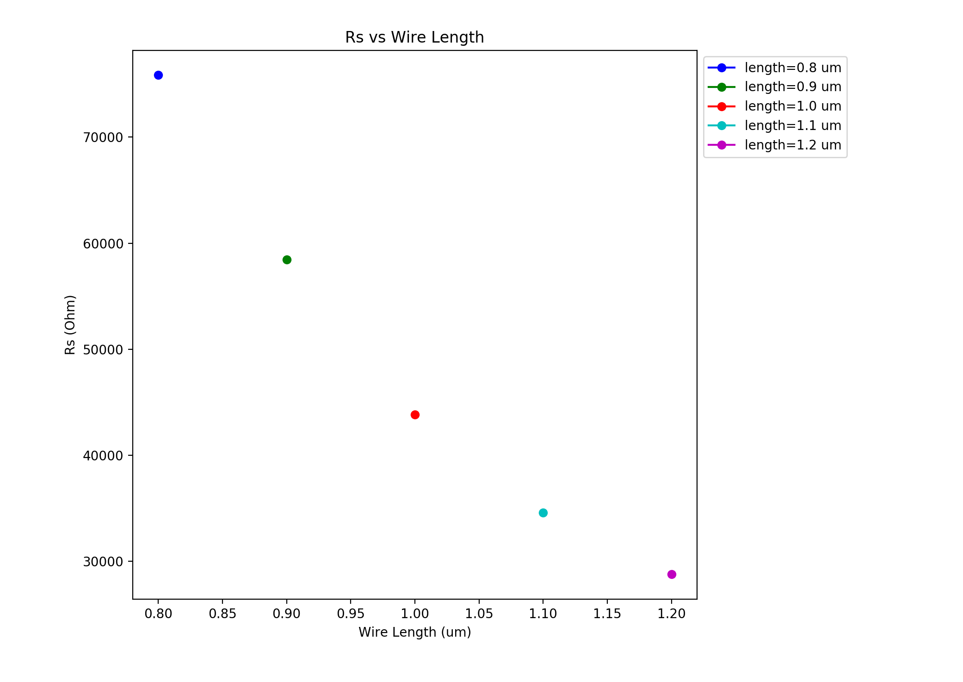
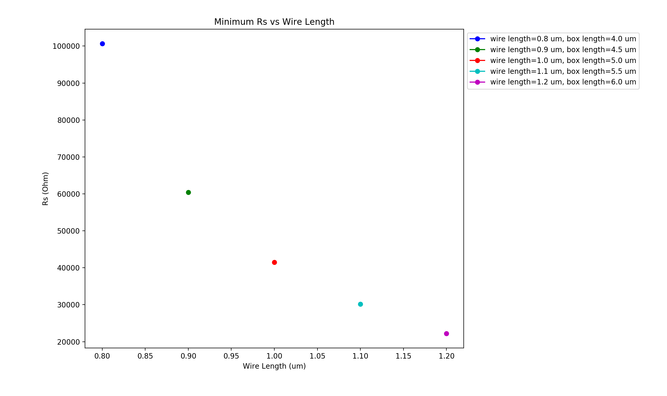
Vary Wire Length – 0.8-1.2 um (0.1um steps) Fixed Box Size (5um) Box Size = 5 x Wire Length
Wire diameter: 1nm, Rjcn: 1Ω, Rwire ≃400kΩ, Samples: 15, uniform wire length,
network density: 6.5644 to 19.6932 in 1.6411 wires/um² steps

Slide 18
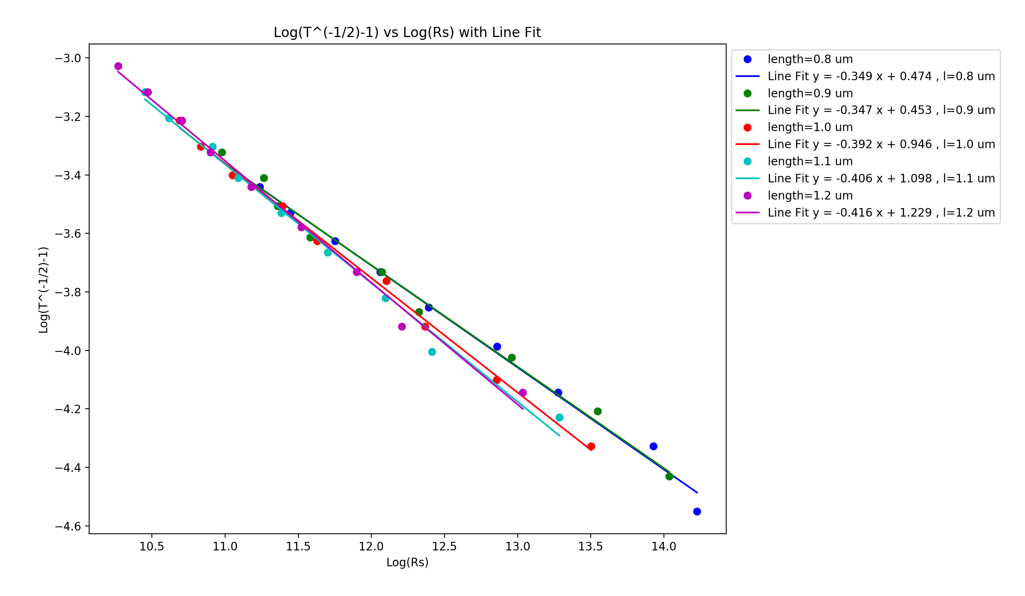
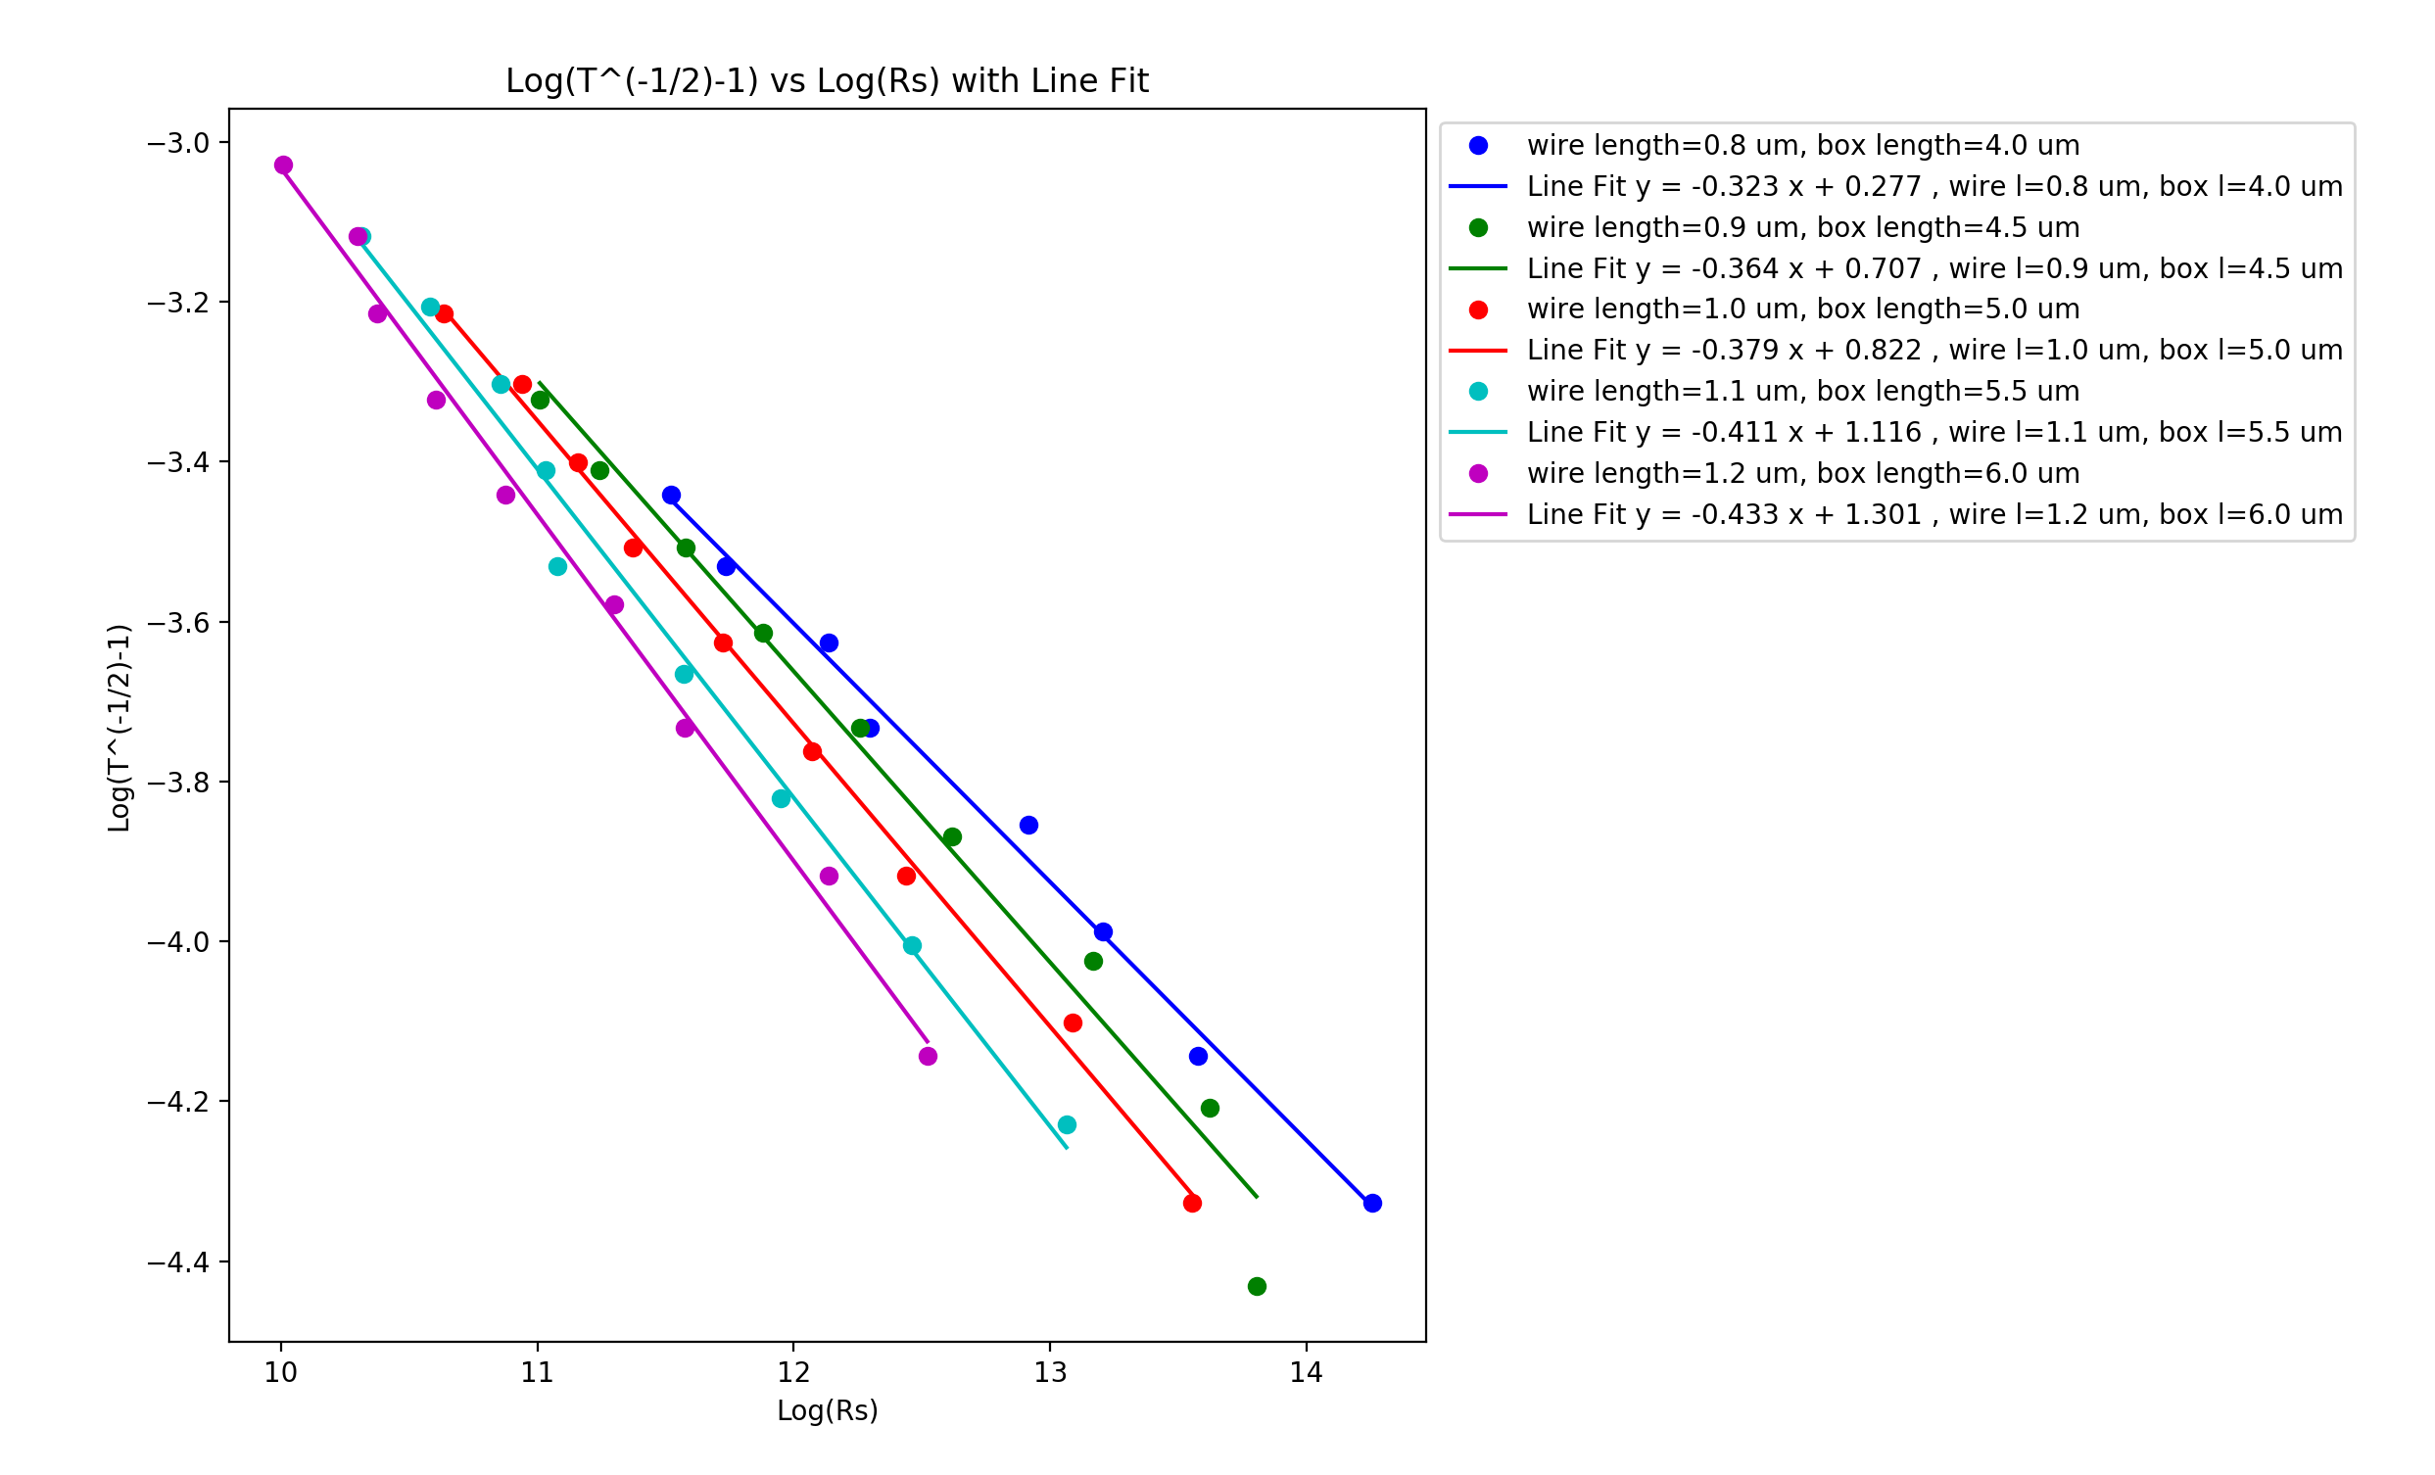
Vary Wire Length – 0.8-1.2 um (0.1um steps) Fixed Box Size (5um) Box Size = 5 x Wire Length
Wire diameter: 1nm, Rjcn: 1Ω, Rwire ≃400kΩ, Samples: 15, uniform wire length,
network density: 6.5644 to 19.6932 in 1.6411 wires/um² steps

Slide 19
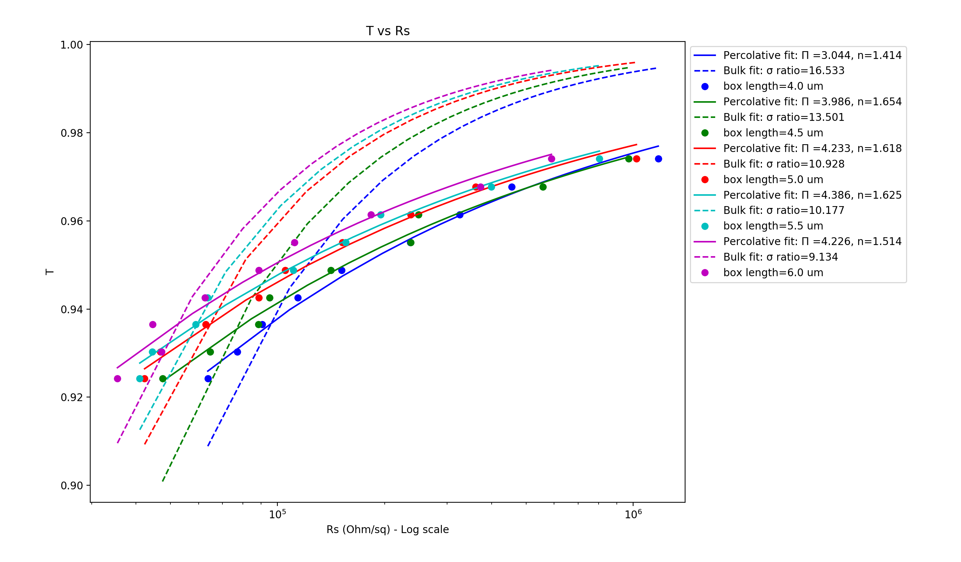
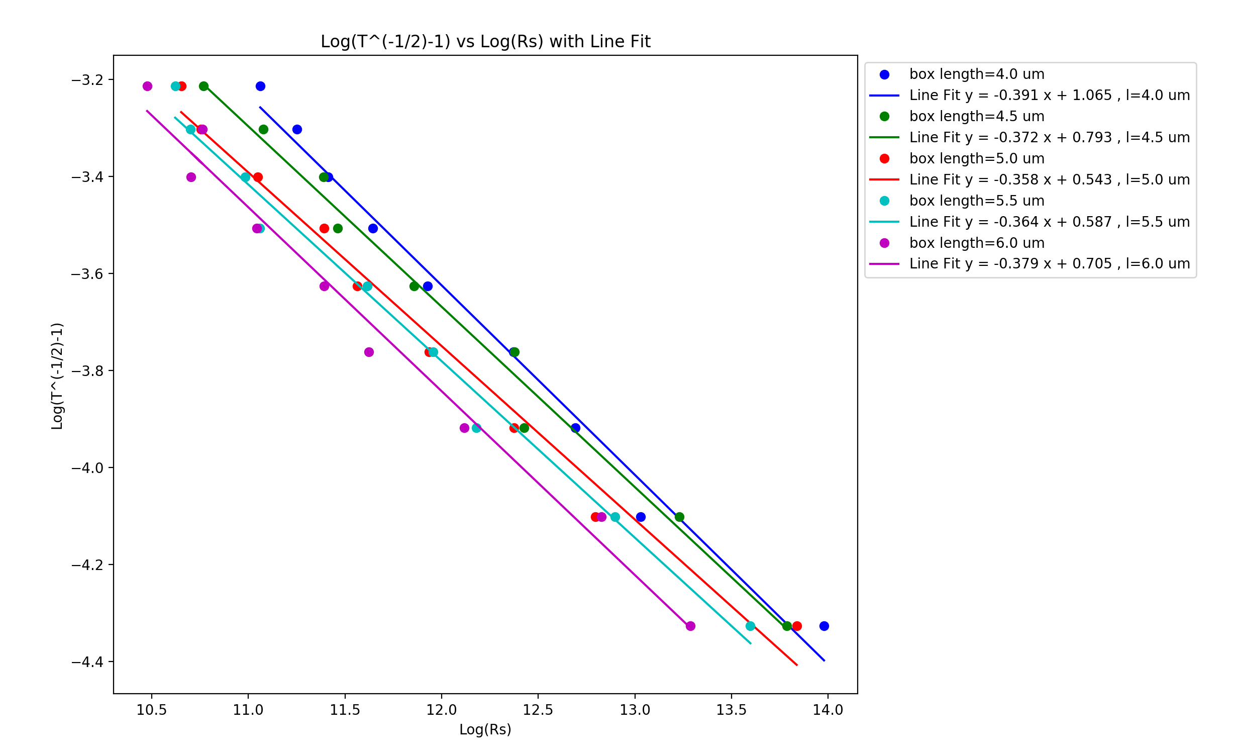
Vary Box Size – 4-6um (0.5um steps)
Wire diameter: 1nm, Wire length: 1um, Rjcn: 1Ω, Rwire ≃400kΩ, Samples: 5, uniform wire length,
network density: 6.5644 to 19.6932 in 1.6411 wires/um² steps

Slide 20
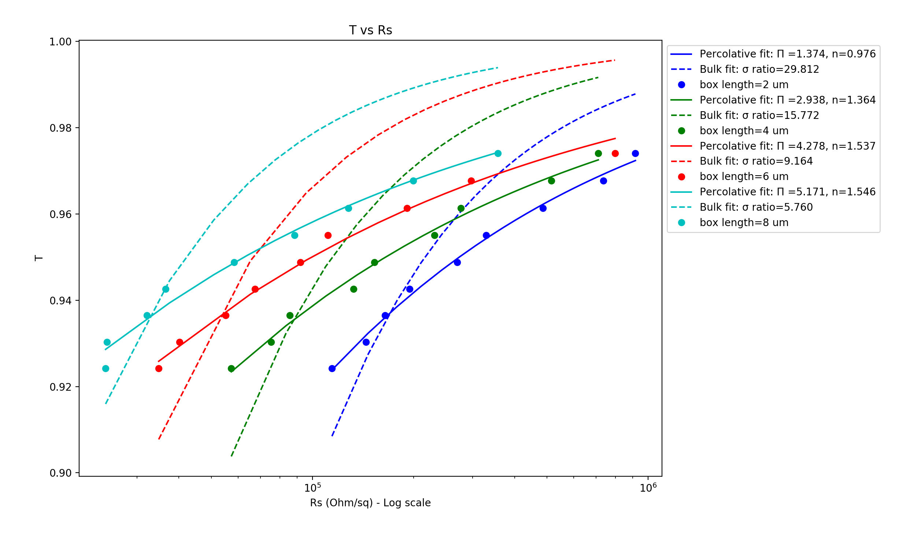
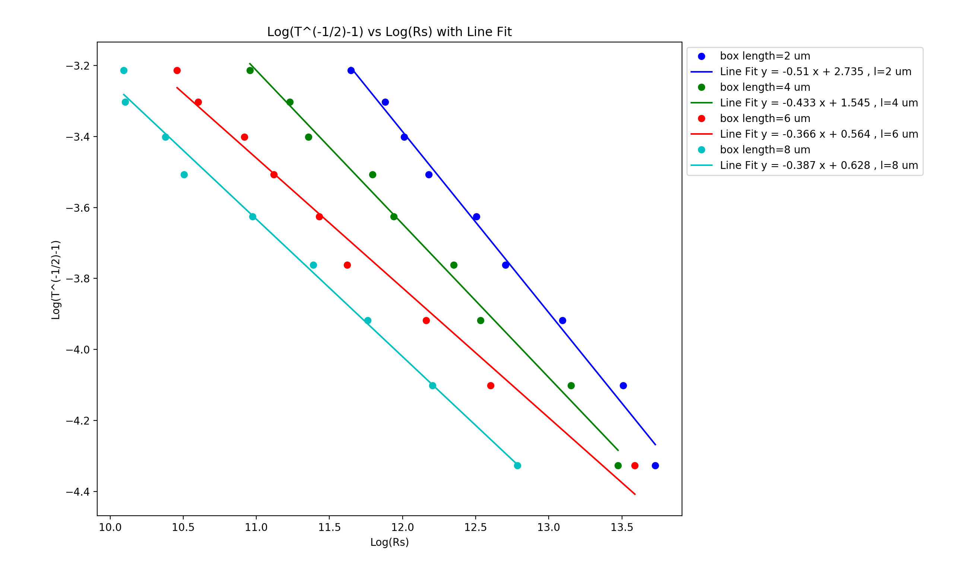
Vary Box Size – 2-8um (2um steps)
Wire diameter: 1nm, Wire length: 1um, Rjcn: 1Ω, Rwire ≃400kΩ, Samples: 5, uniform wire length,
network density: 6.5644 to 19.6932 in 1.6411 wires/um² steps

Slide 21
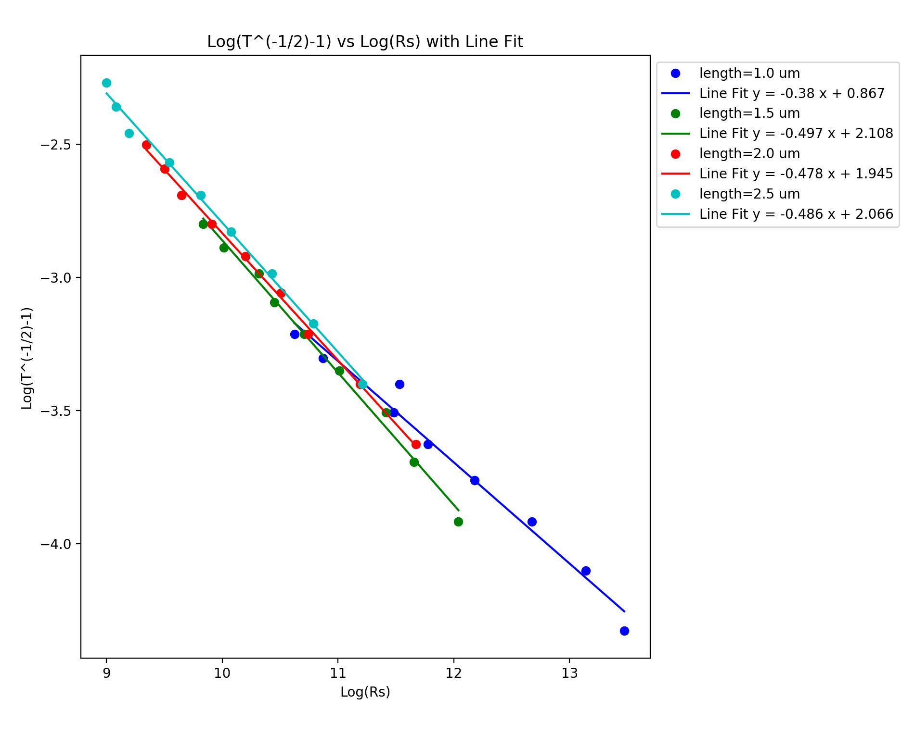
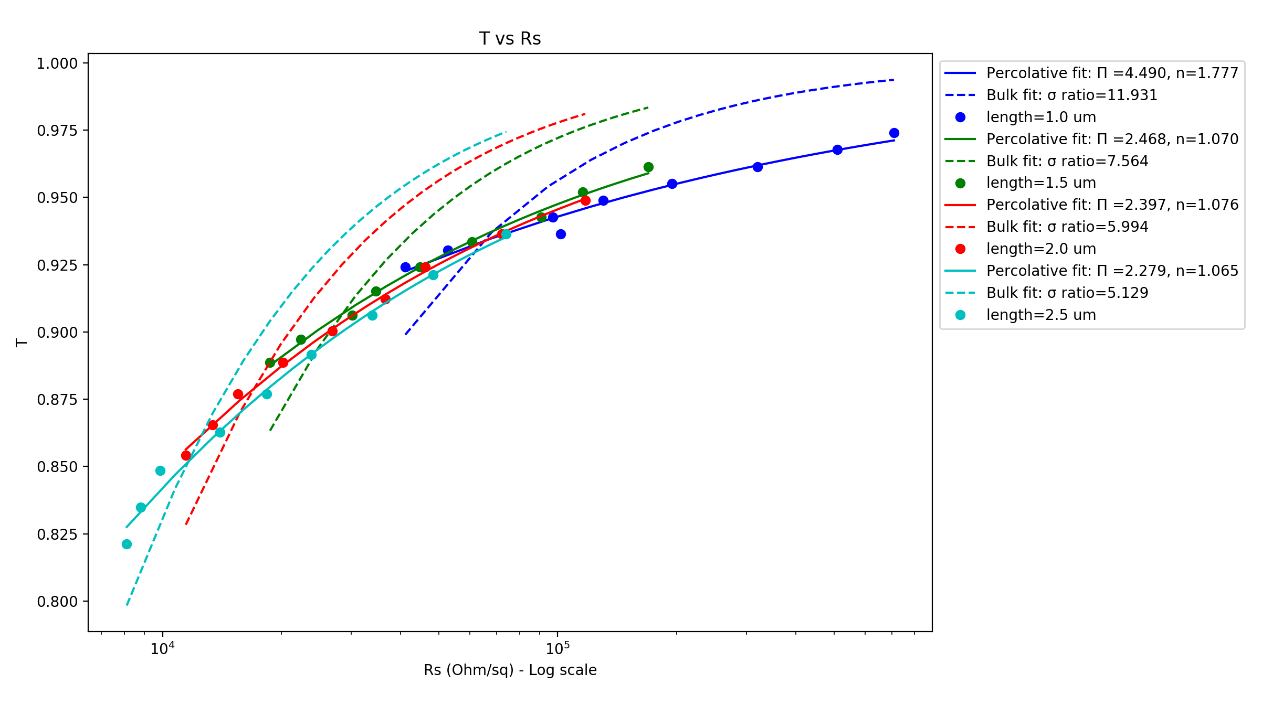
Vary Wire Length – 1-2.5 um (0.5um steps)
Wire diameter: 1nm, Box length: 5um, Rjcn: 1Ω, Rwire ≃400kΩ, Samples: 3, uniform wire length,
network density: 6.5644 to 19.6932 in 1.6411 wires/um² steps

Slide 22
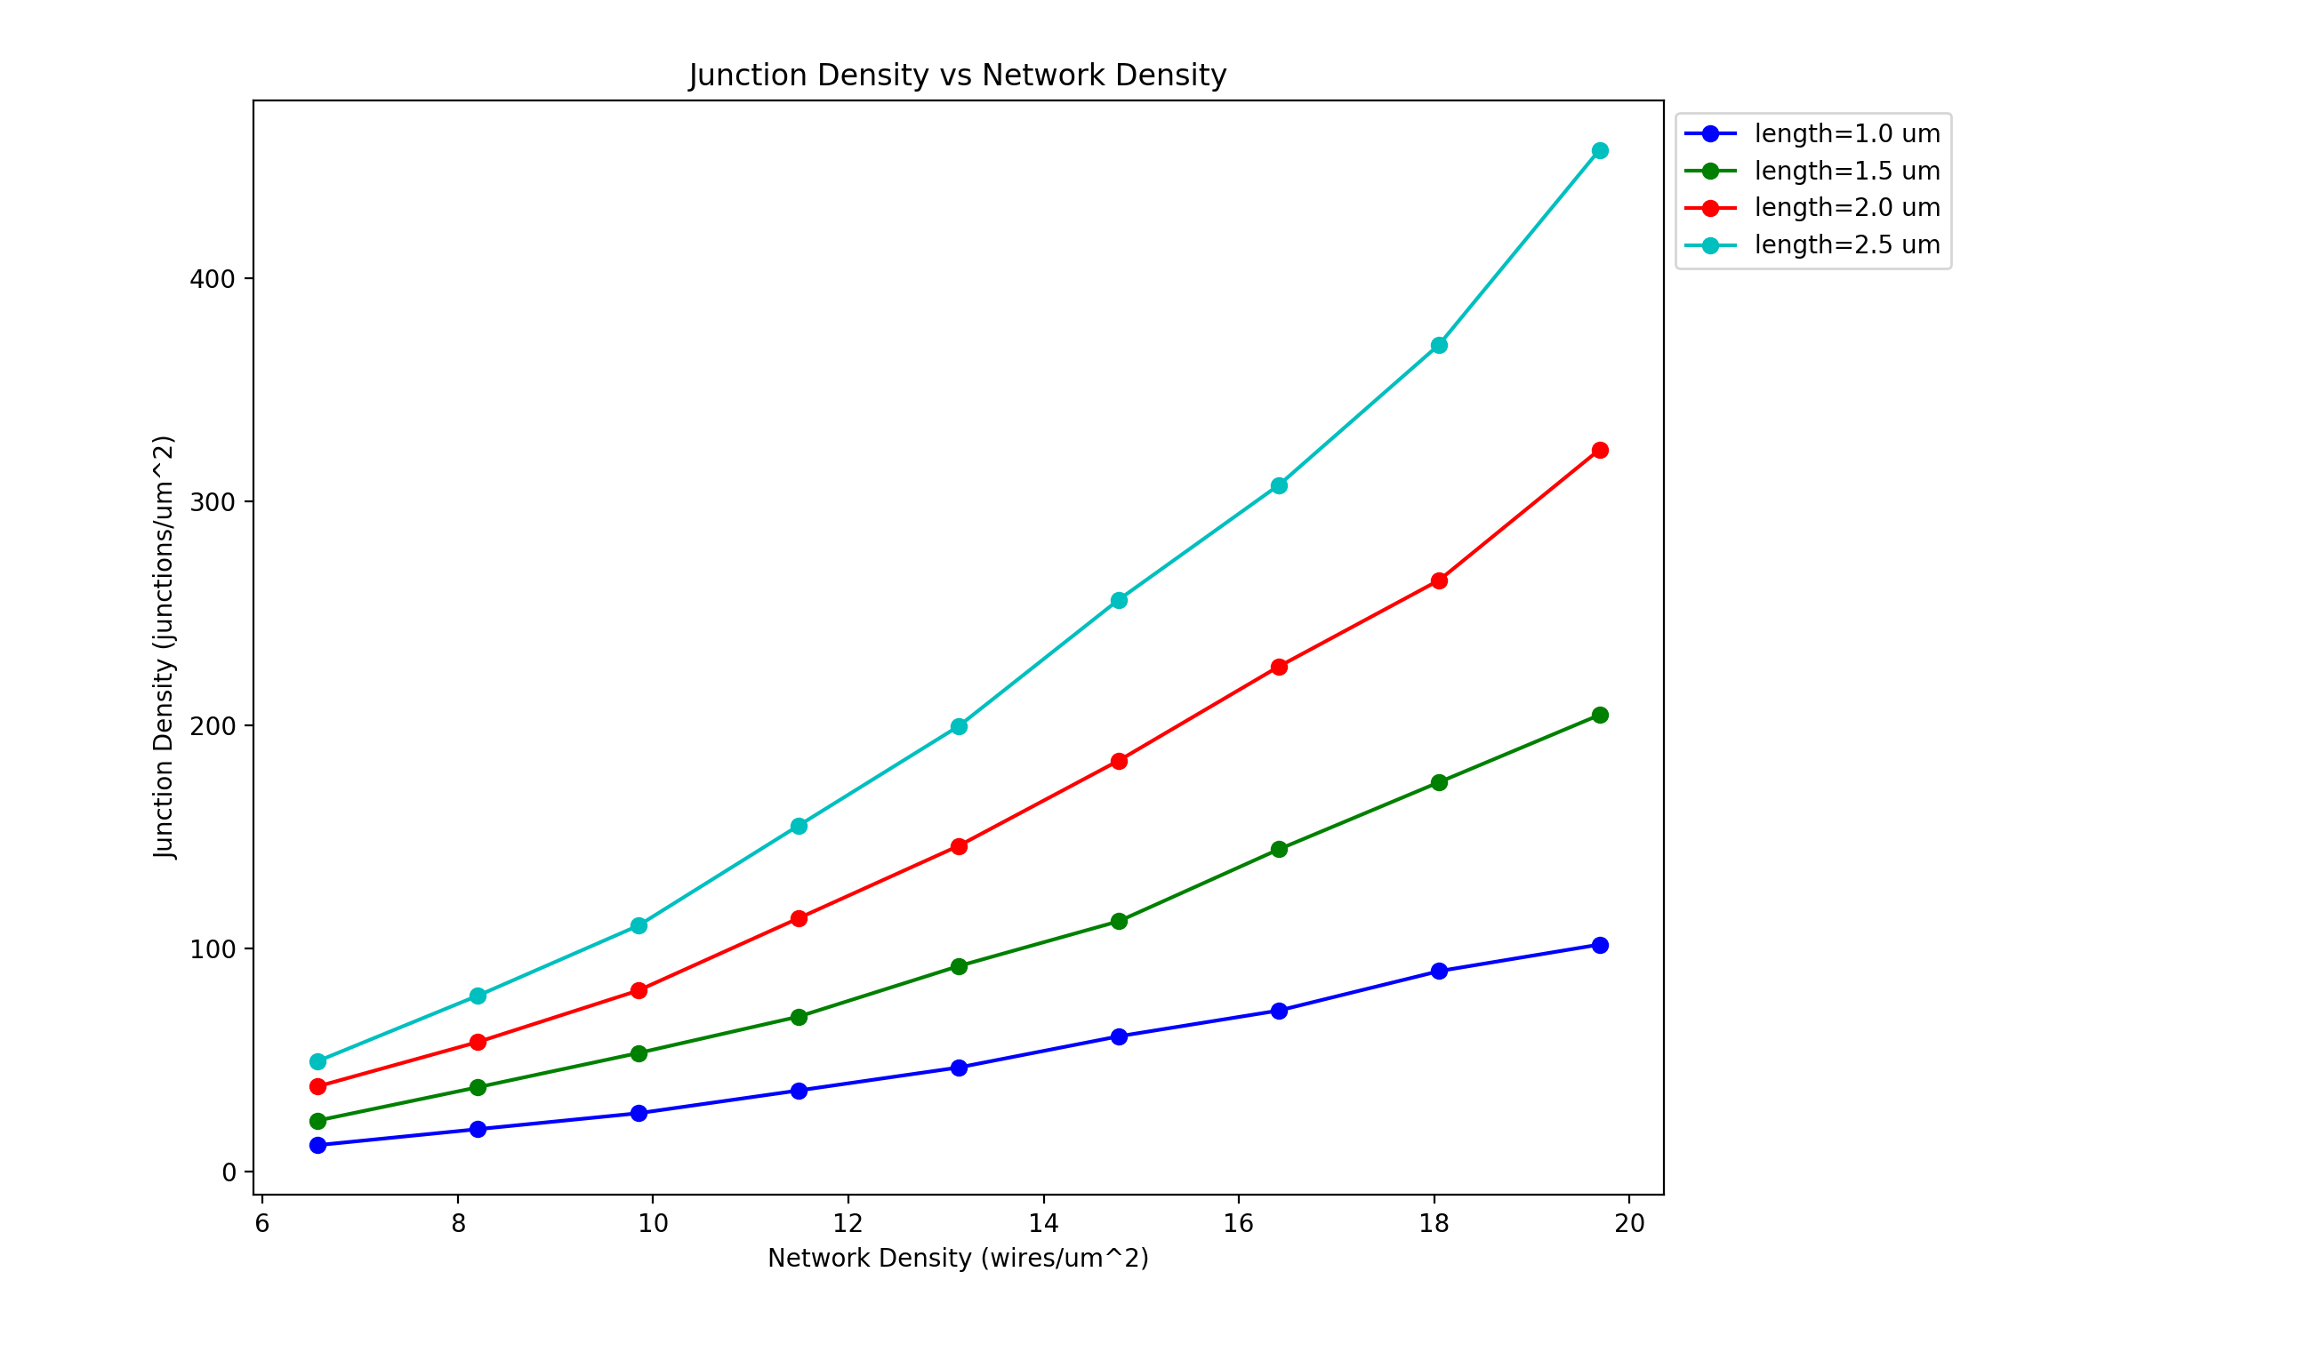
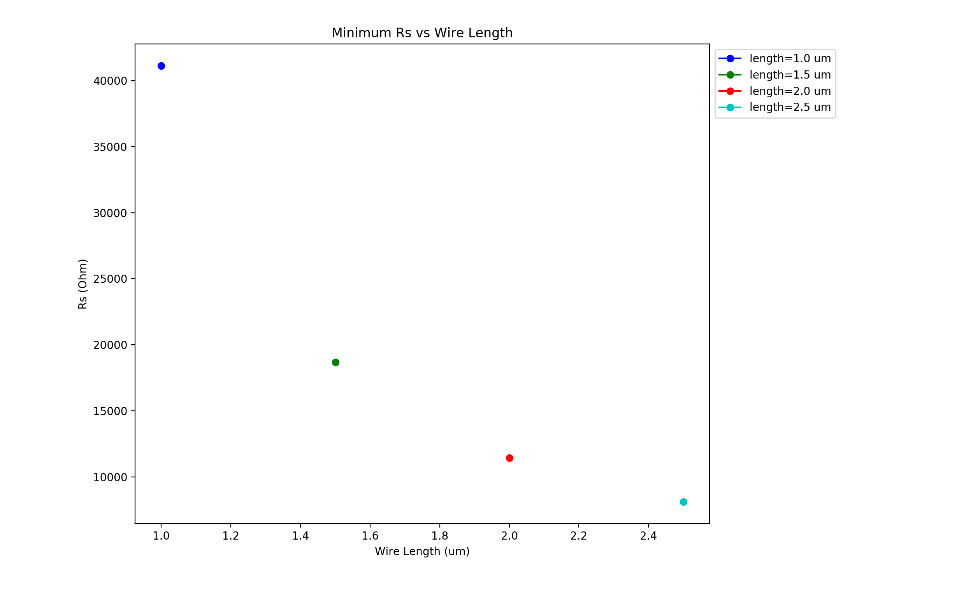
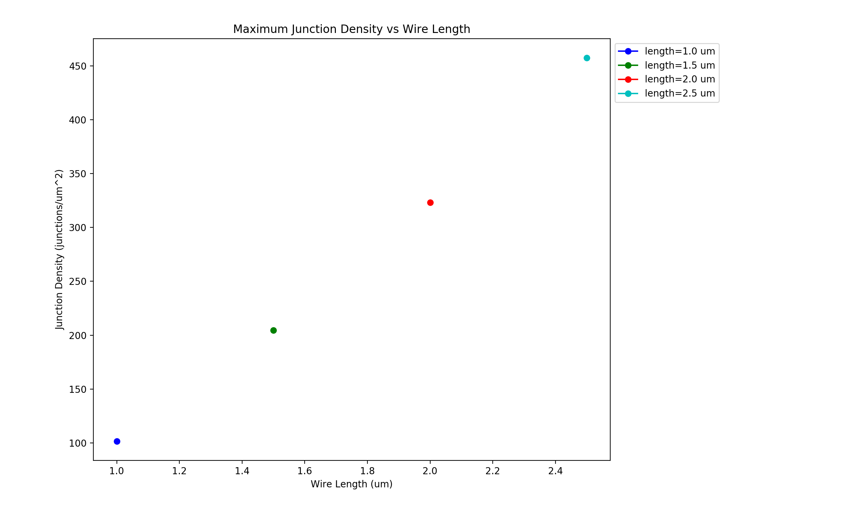
Vary Wire Length – 1-2.5 um (0.5um steps)
Wire diameter: 1nm, Box length: 5um, Rjcn: 1Ω, Rwire ≃400kΩ, Samples: 3, uniform wire length,
network density: 6.5644 to 19.6932 in 1.6411 wires/um² steps

